Slide 1
WebQuiz Prototype
Work in progress…
Green arrows indicate where you should click to continue with the prototype. If there are more than one arrows then you can click either.

Slide 2
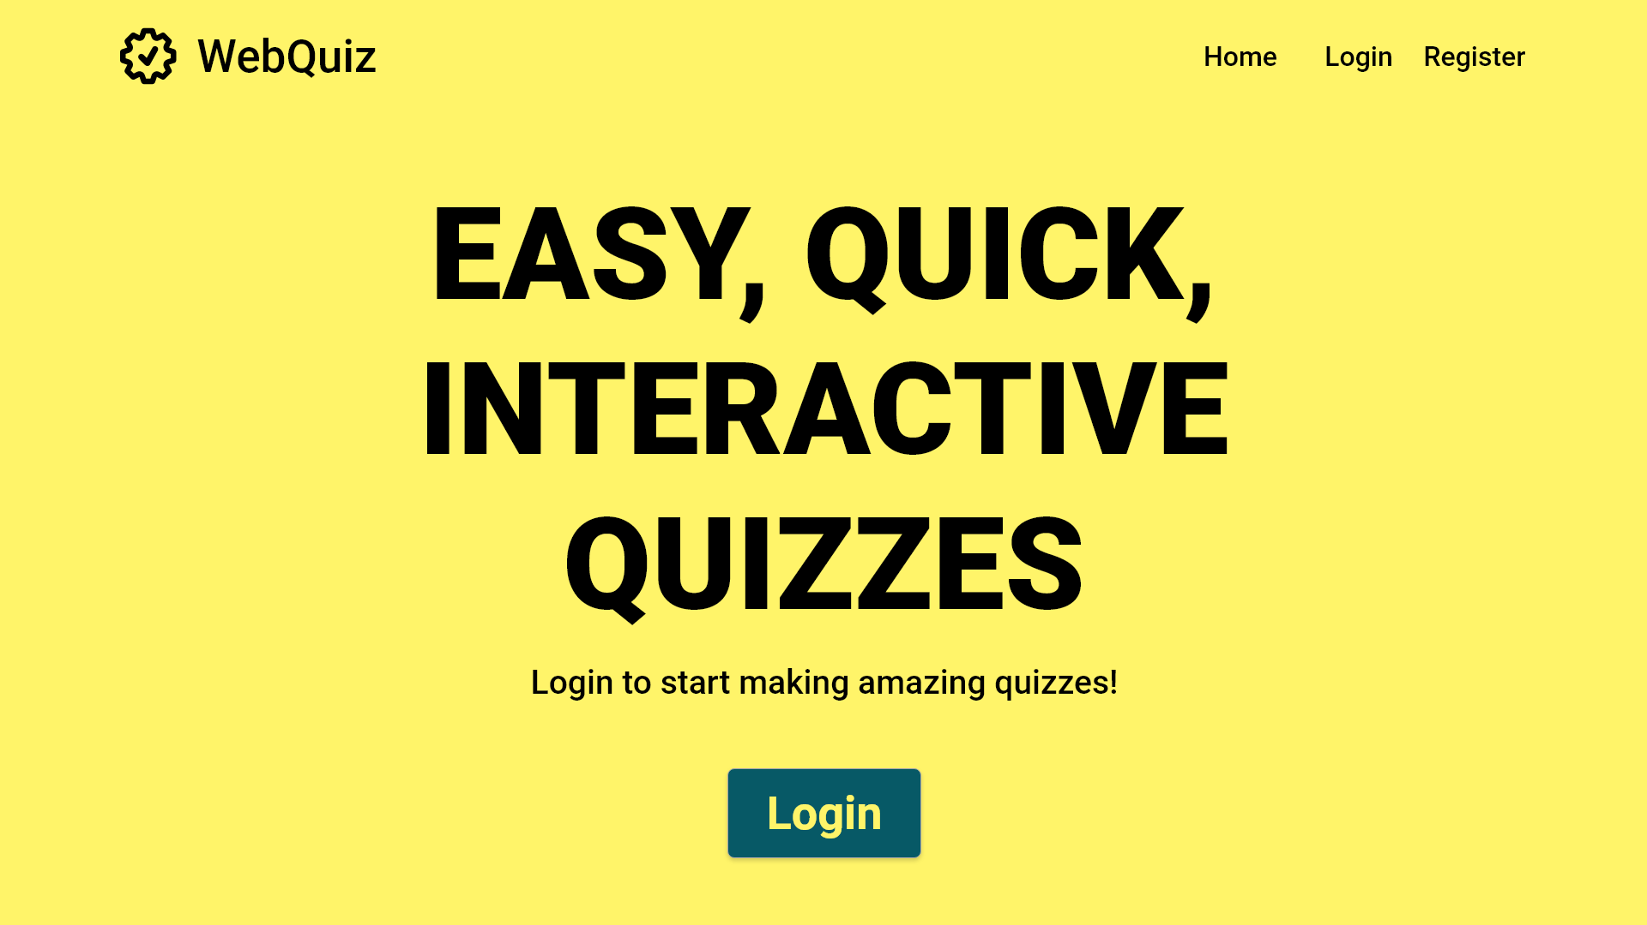
If the Quiz Maintainer does not have an account, one can be registered here

Slide 3
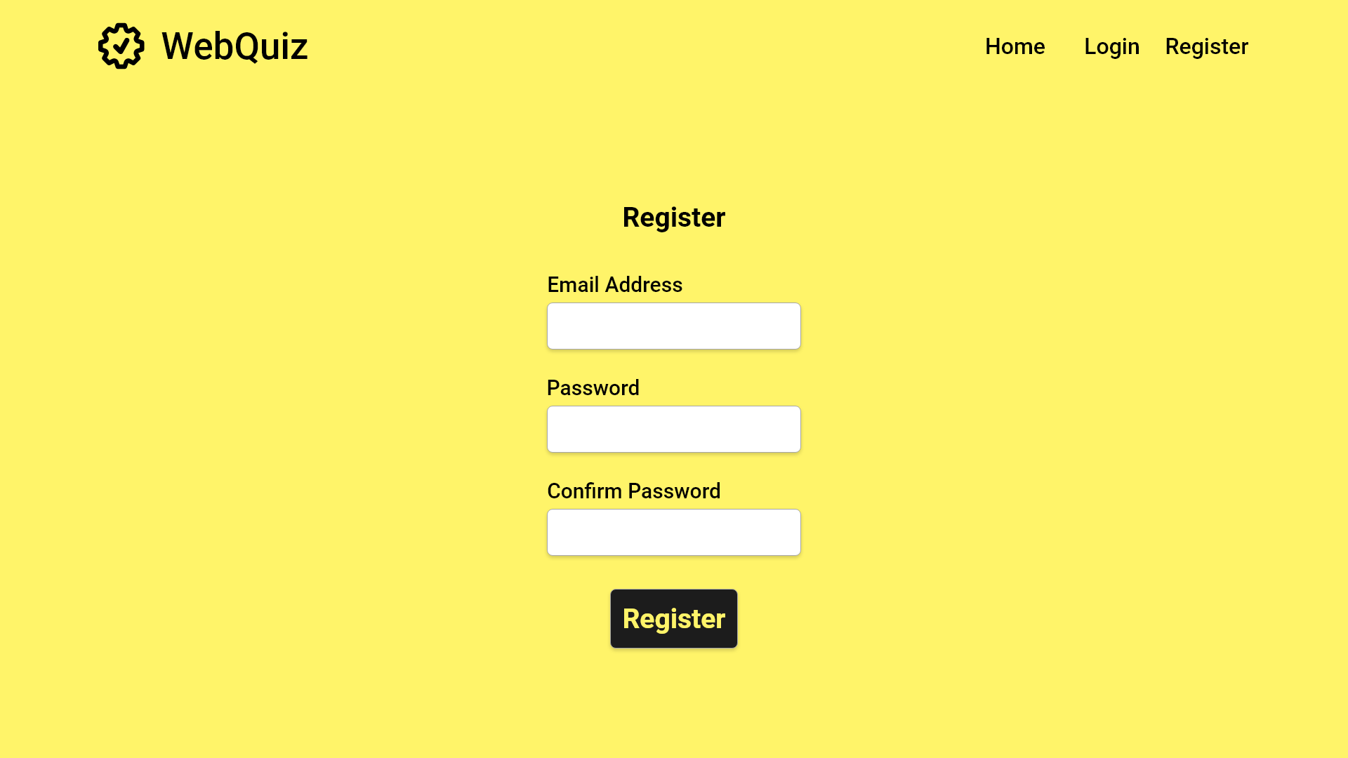
User fills in both text boxes
Start Register
Click the button once forms are filled
Error case

Slide 4
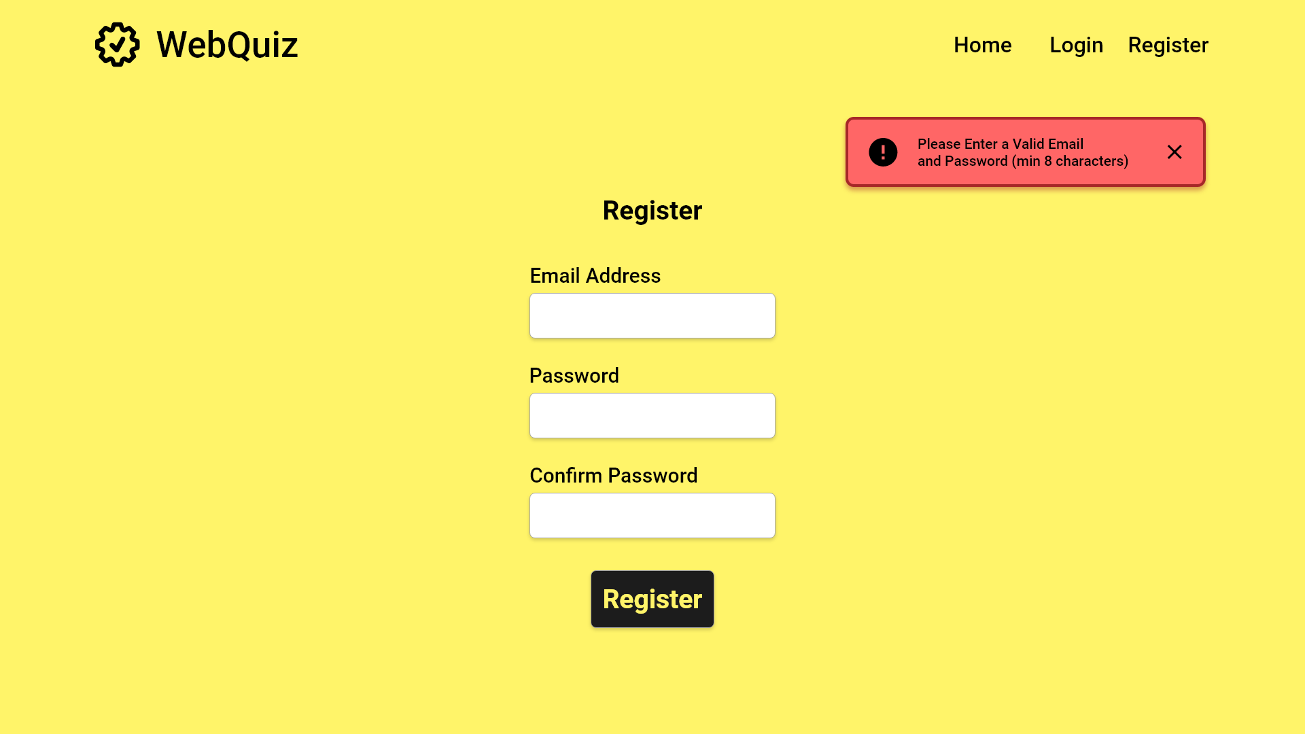
An error message will be returned if either box is left blank
User fills in both text boxes
Click the button once forms are filled

Slide 5
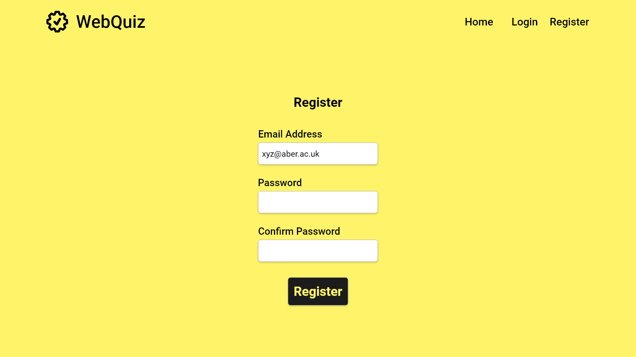

Slide 6
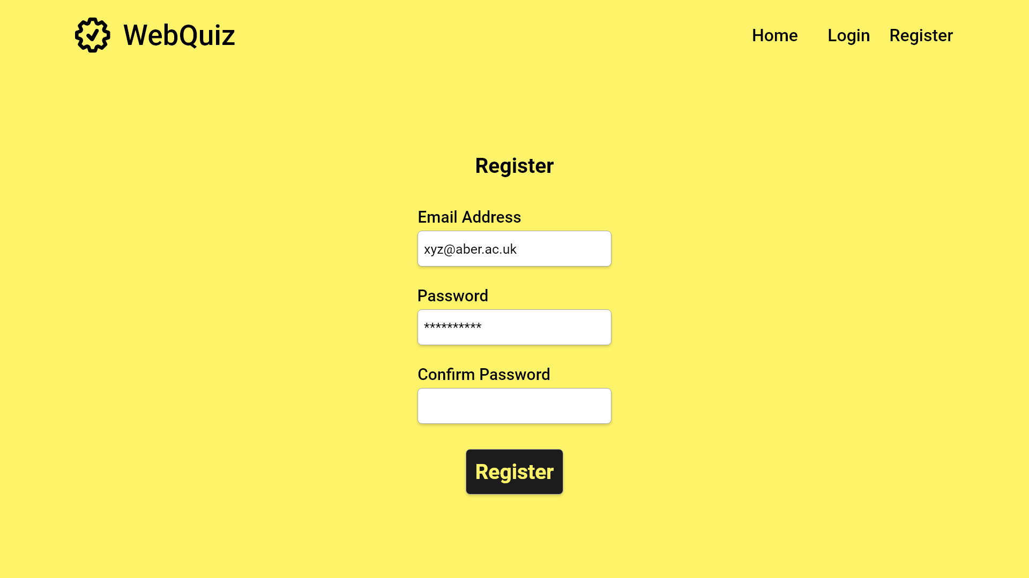

Slide 7


Slide 9
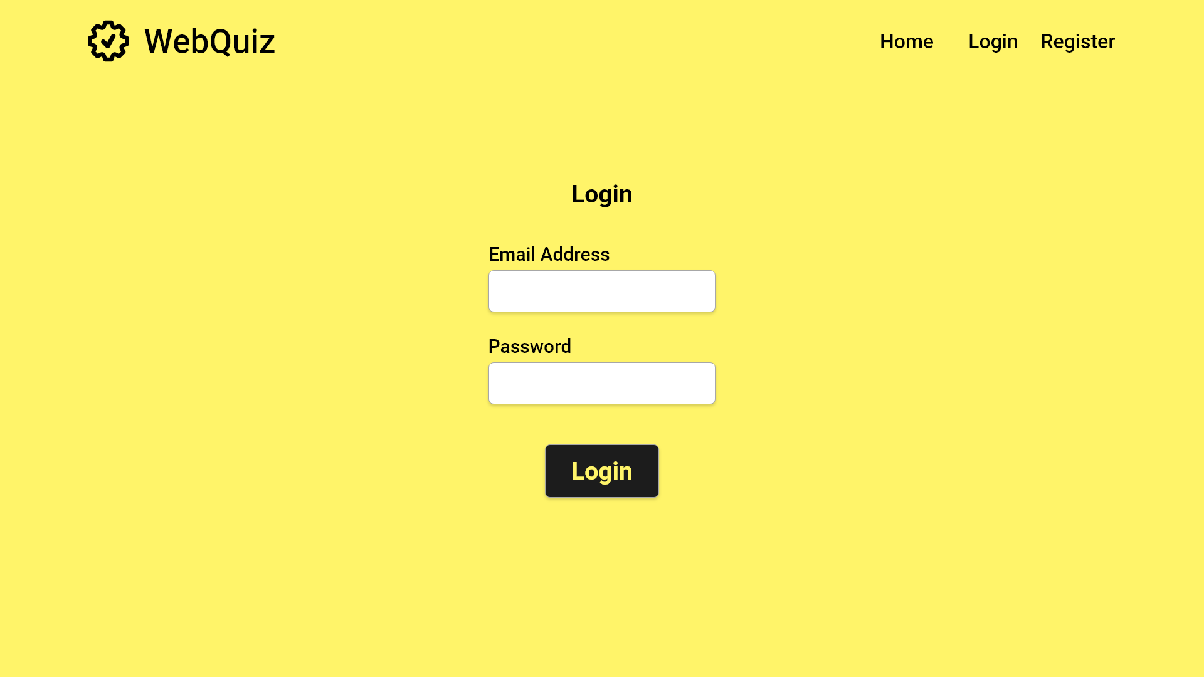
Error Case

Slide 10
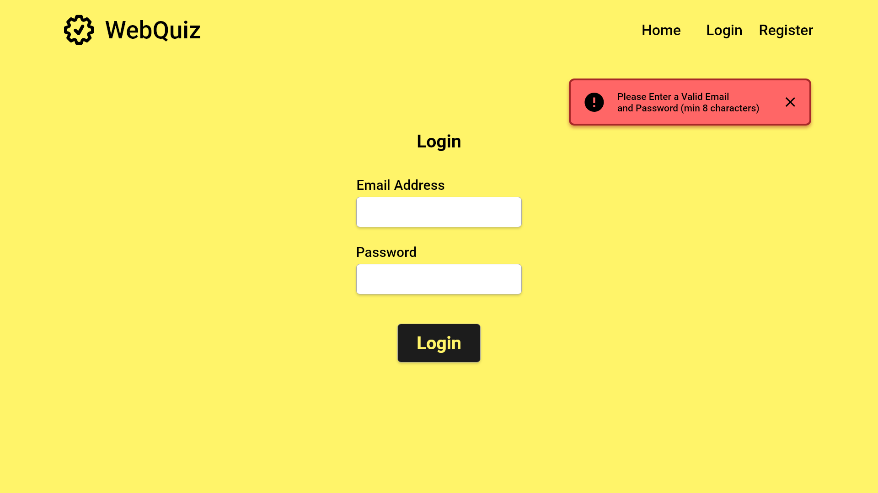

Slide 12


Slide 13
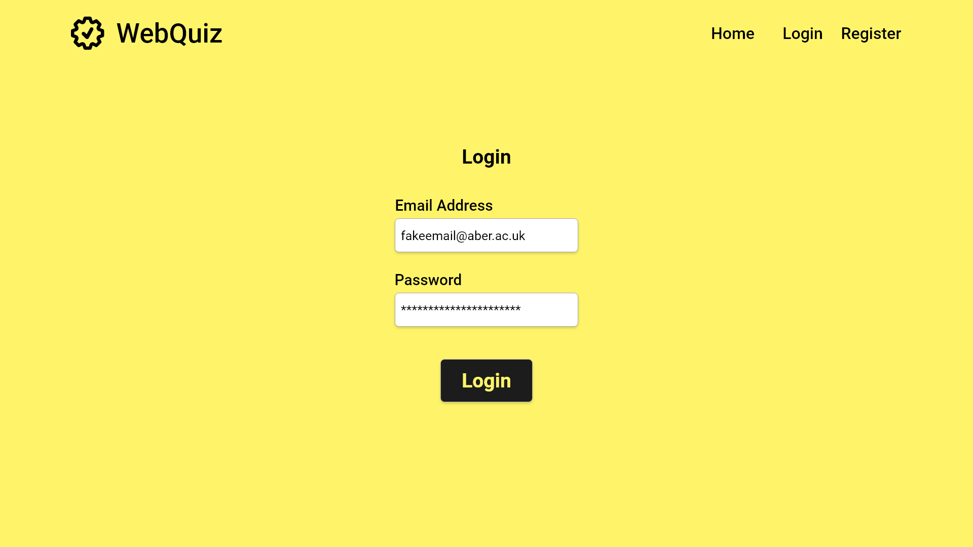

Slide 14
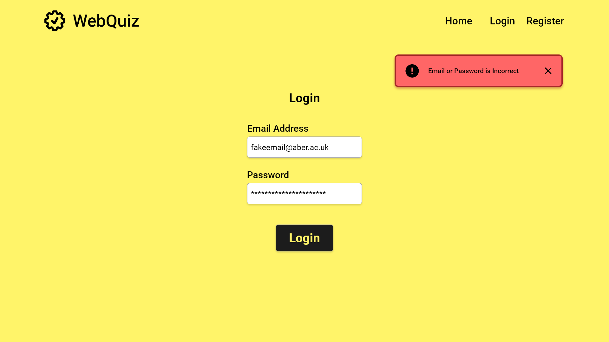

Slide 16
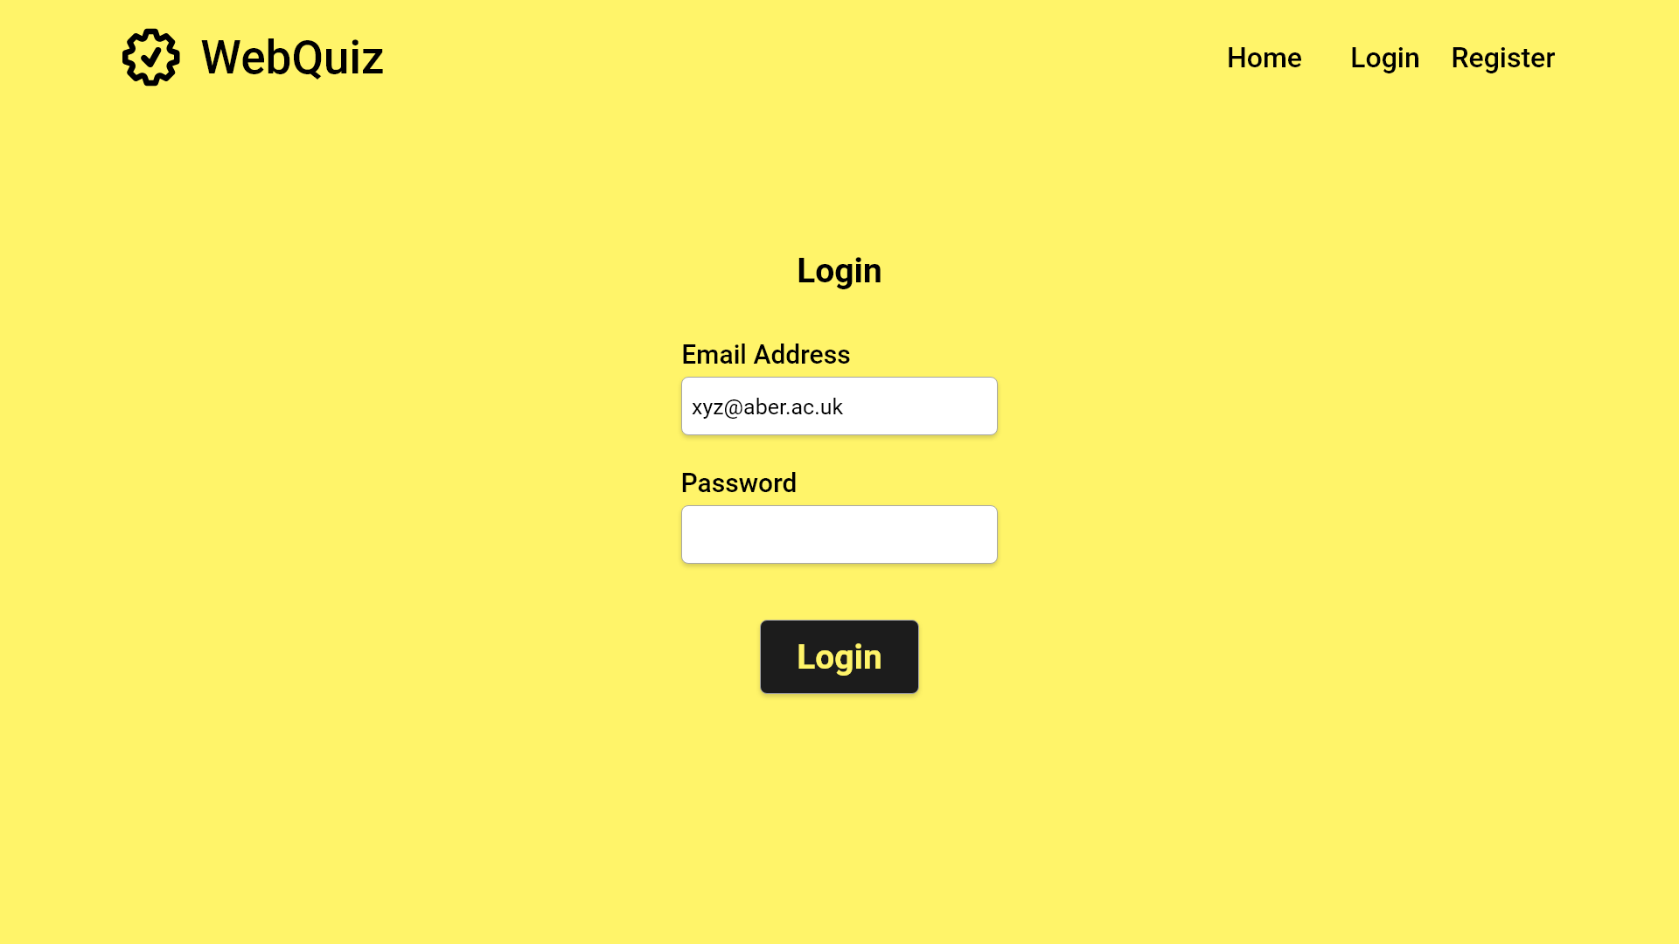

Slide 17
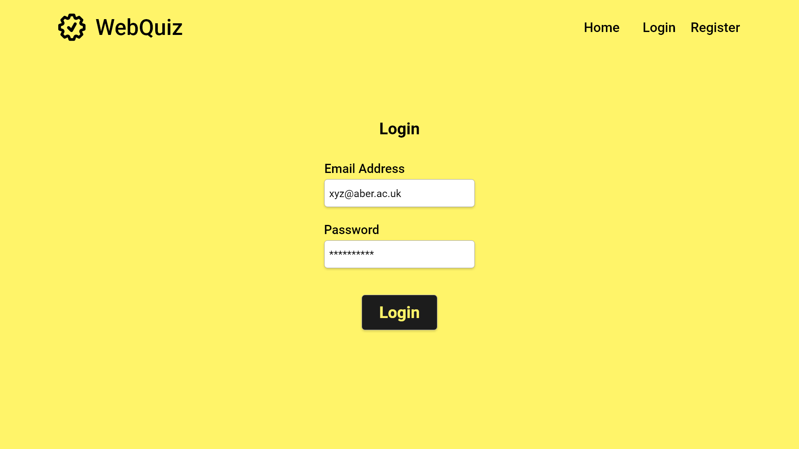

Slide 18
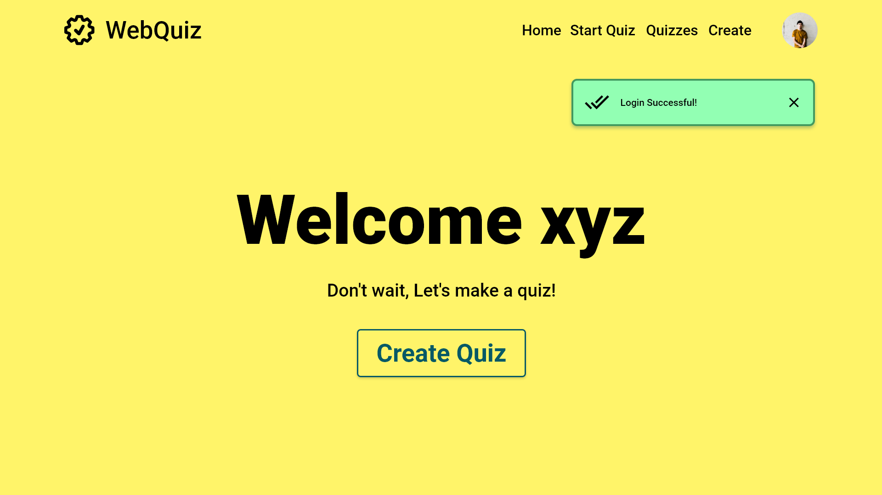
Close success message
Start Quiz Creation

Slide 19
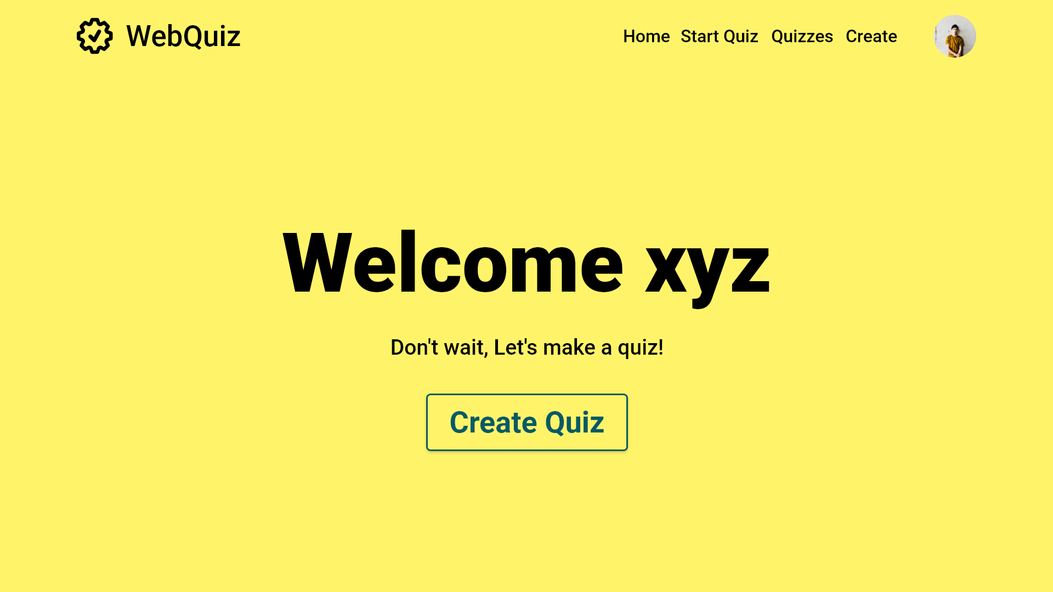
Start Quiz Creation
Start Quiz Creation

Slide 20
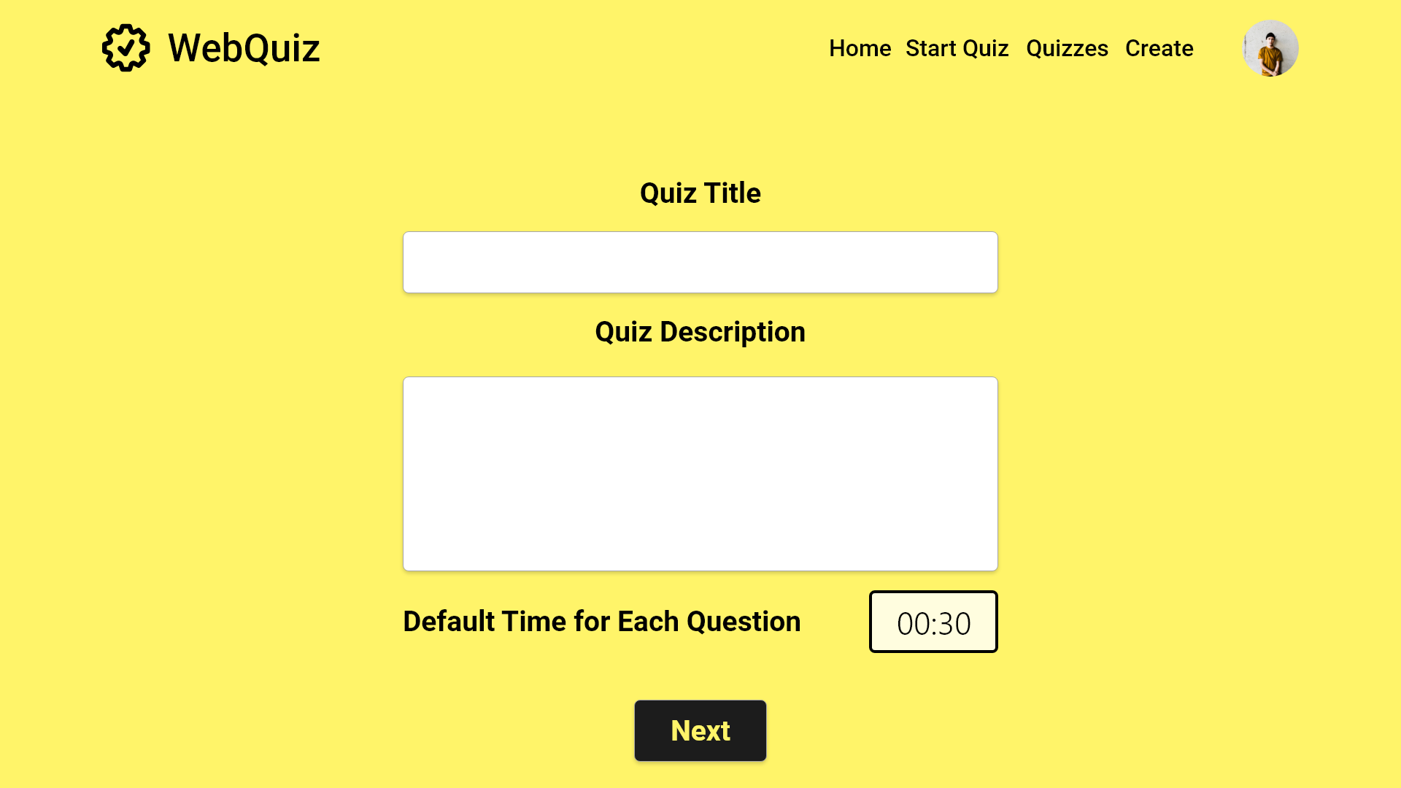

Slide 21
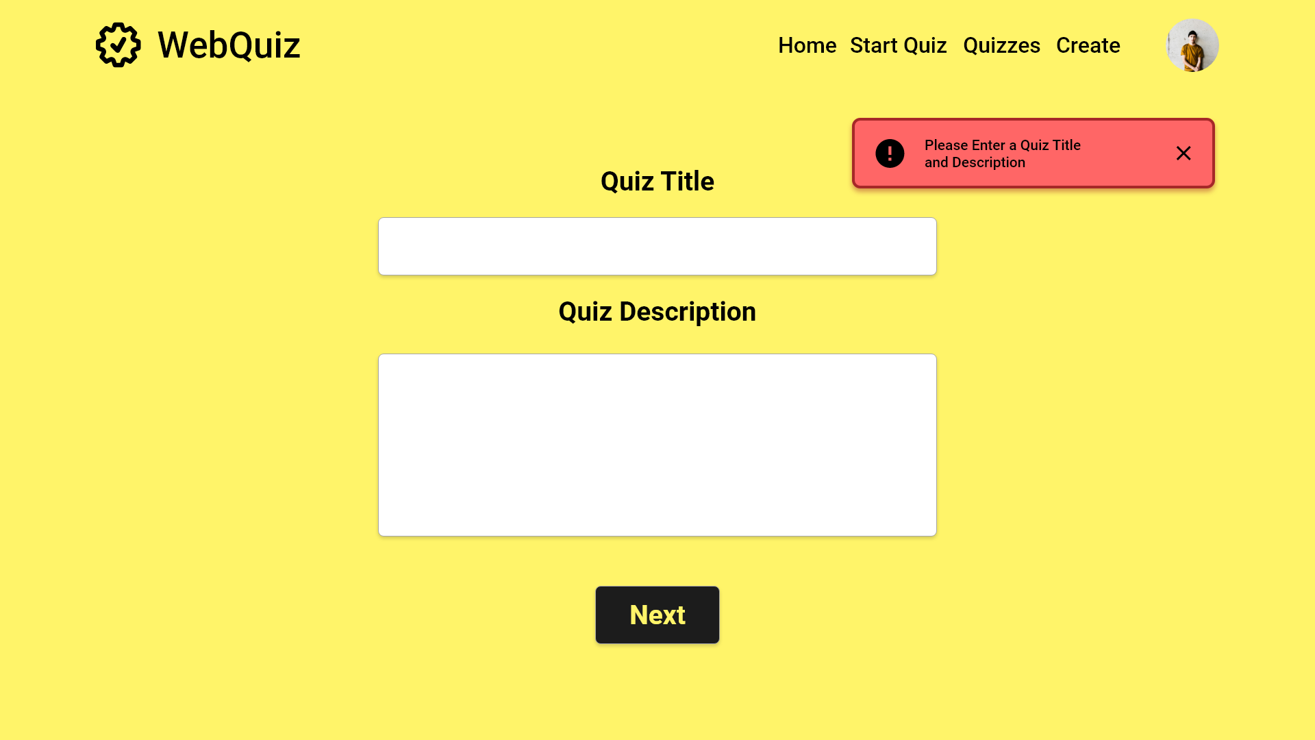
Close error message

Slide 22
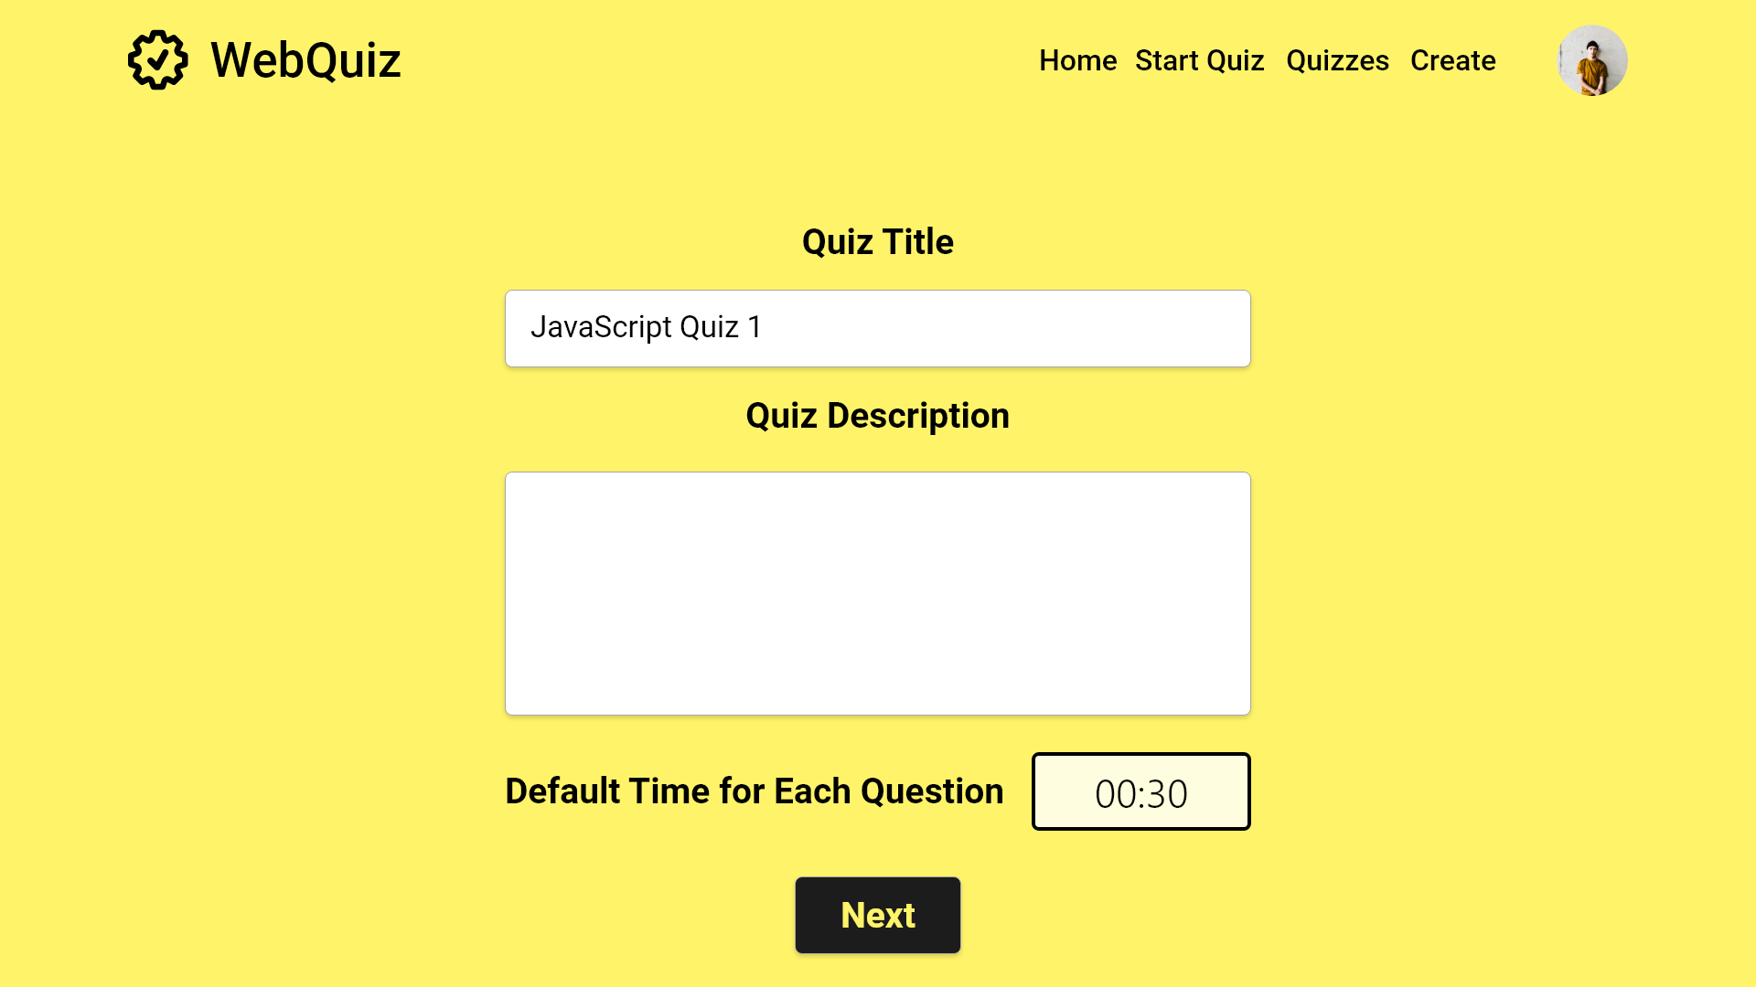

Slide 23
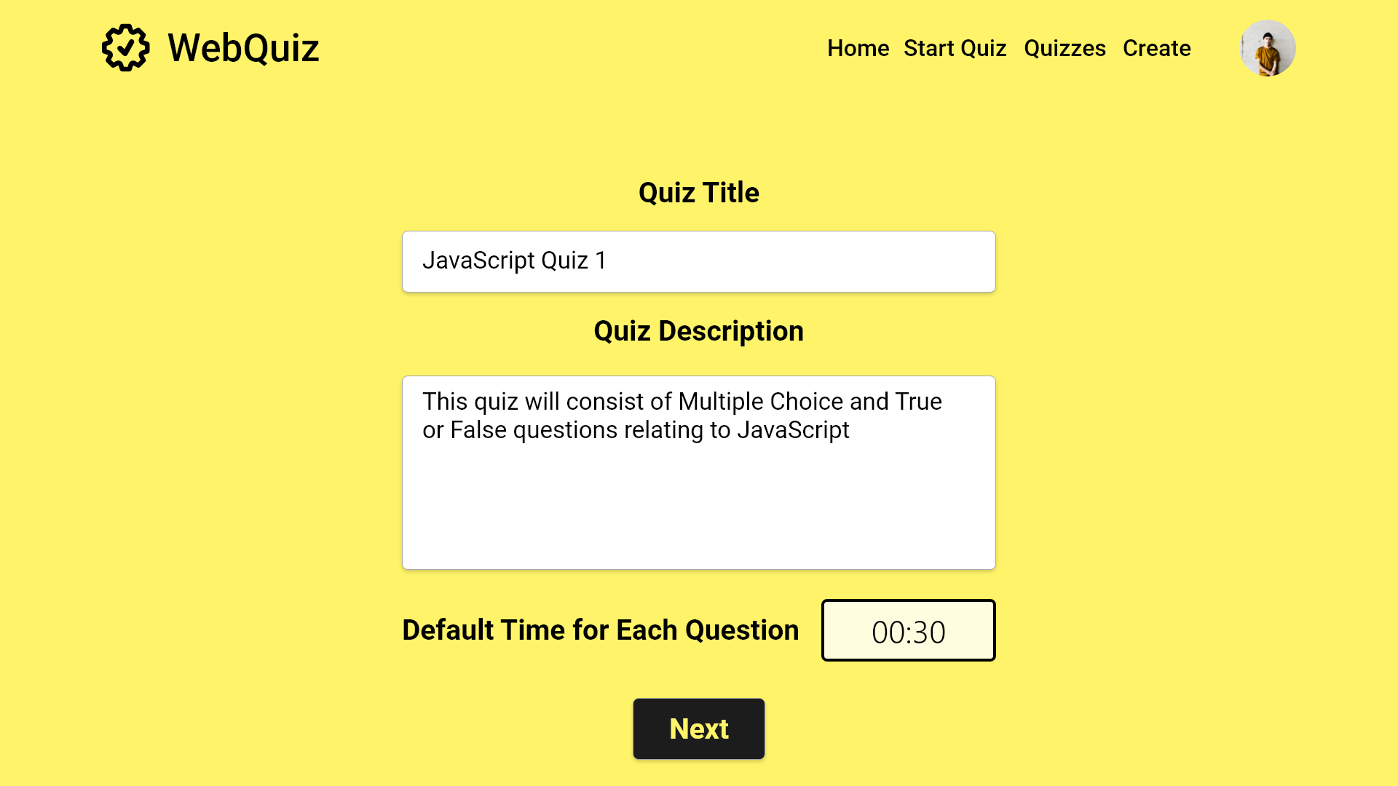

Slide 24
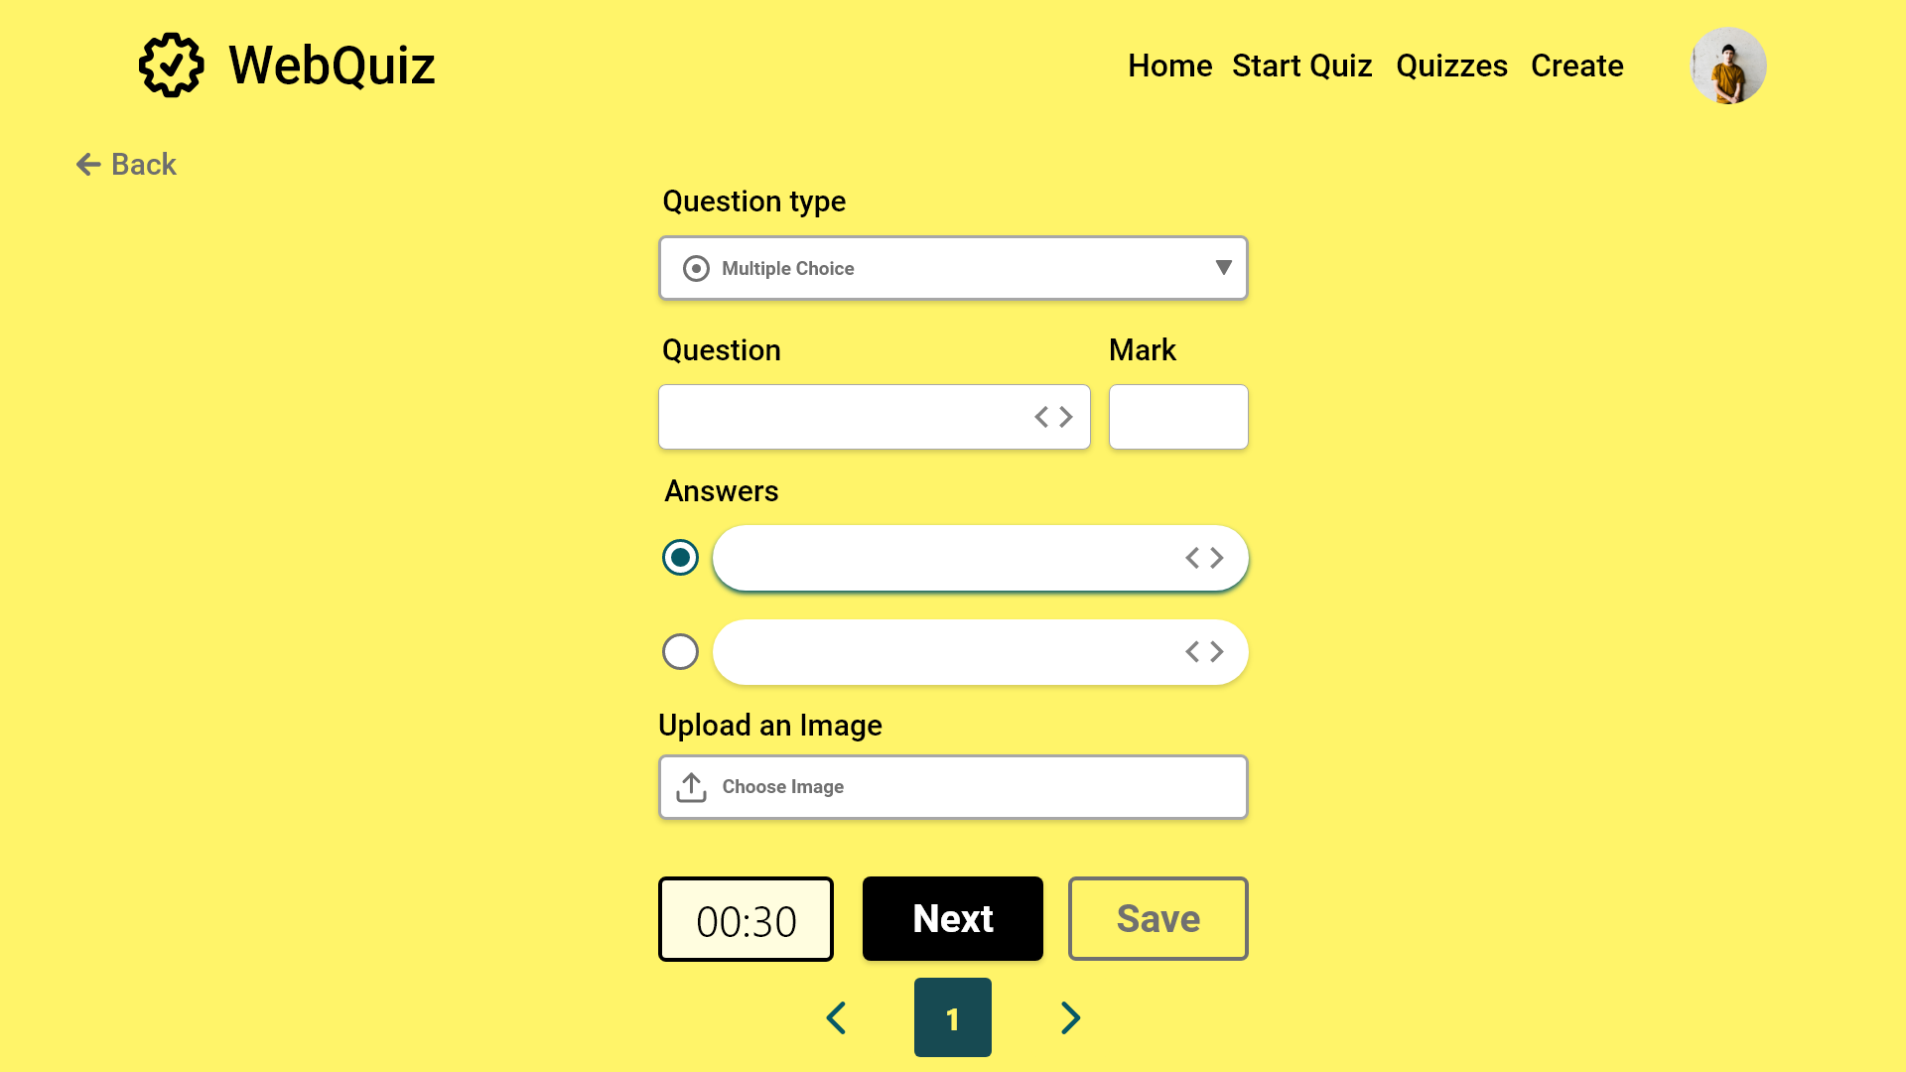
Error case

Slide 25
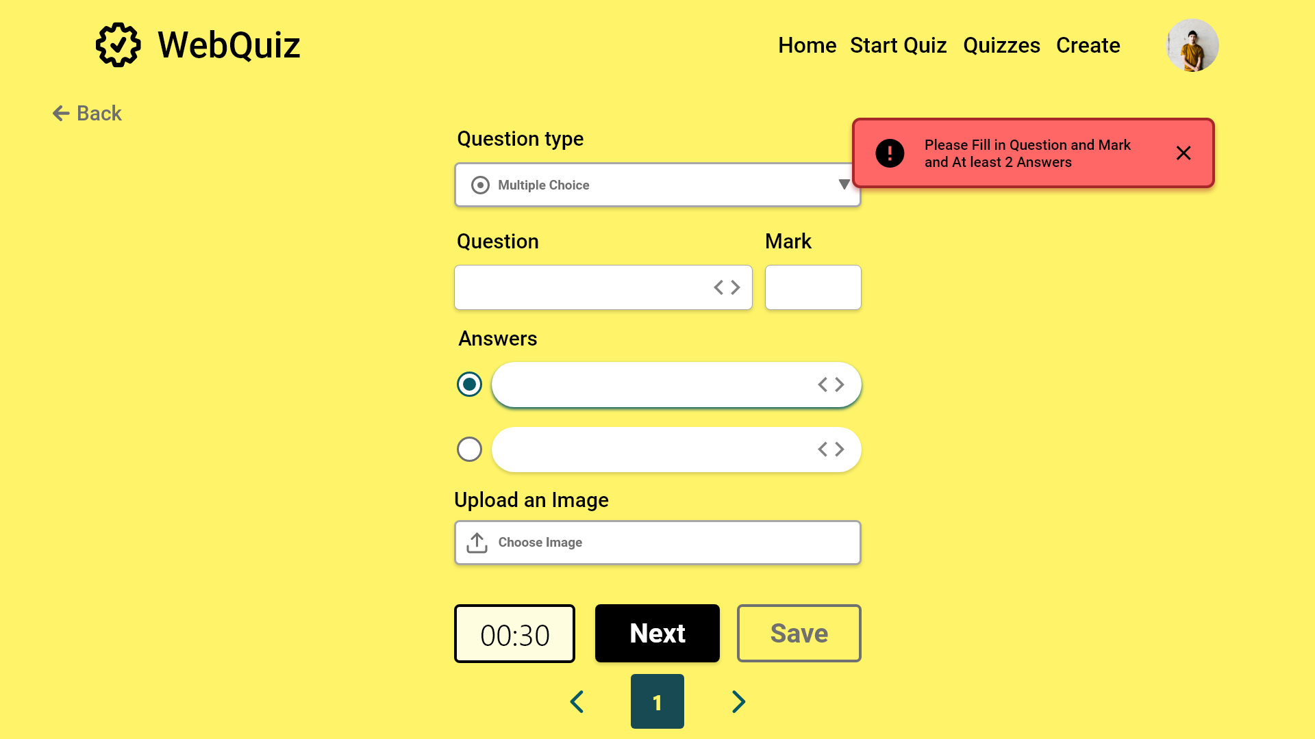

Slide 26
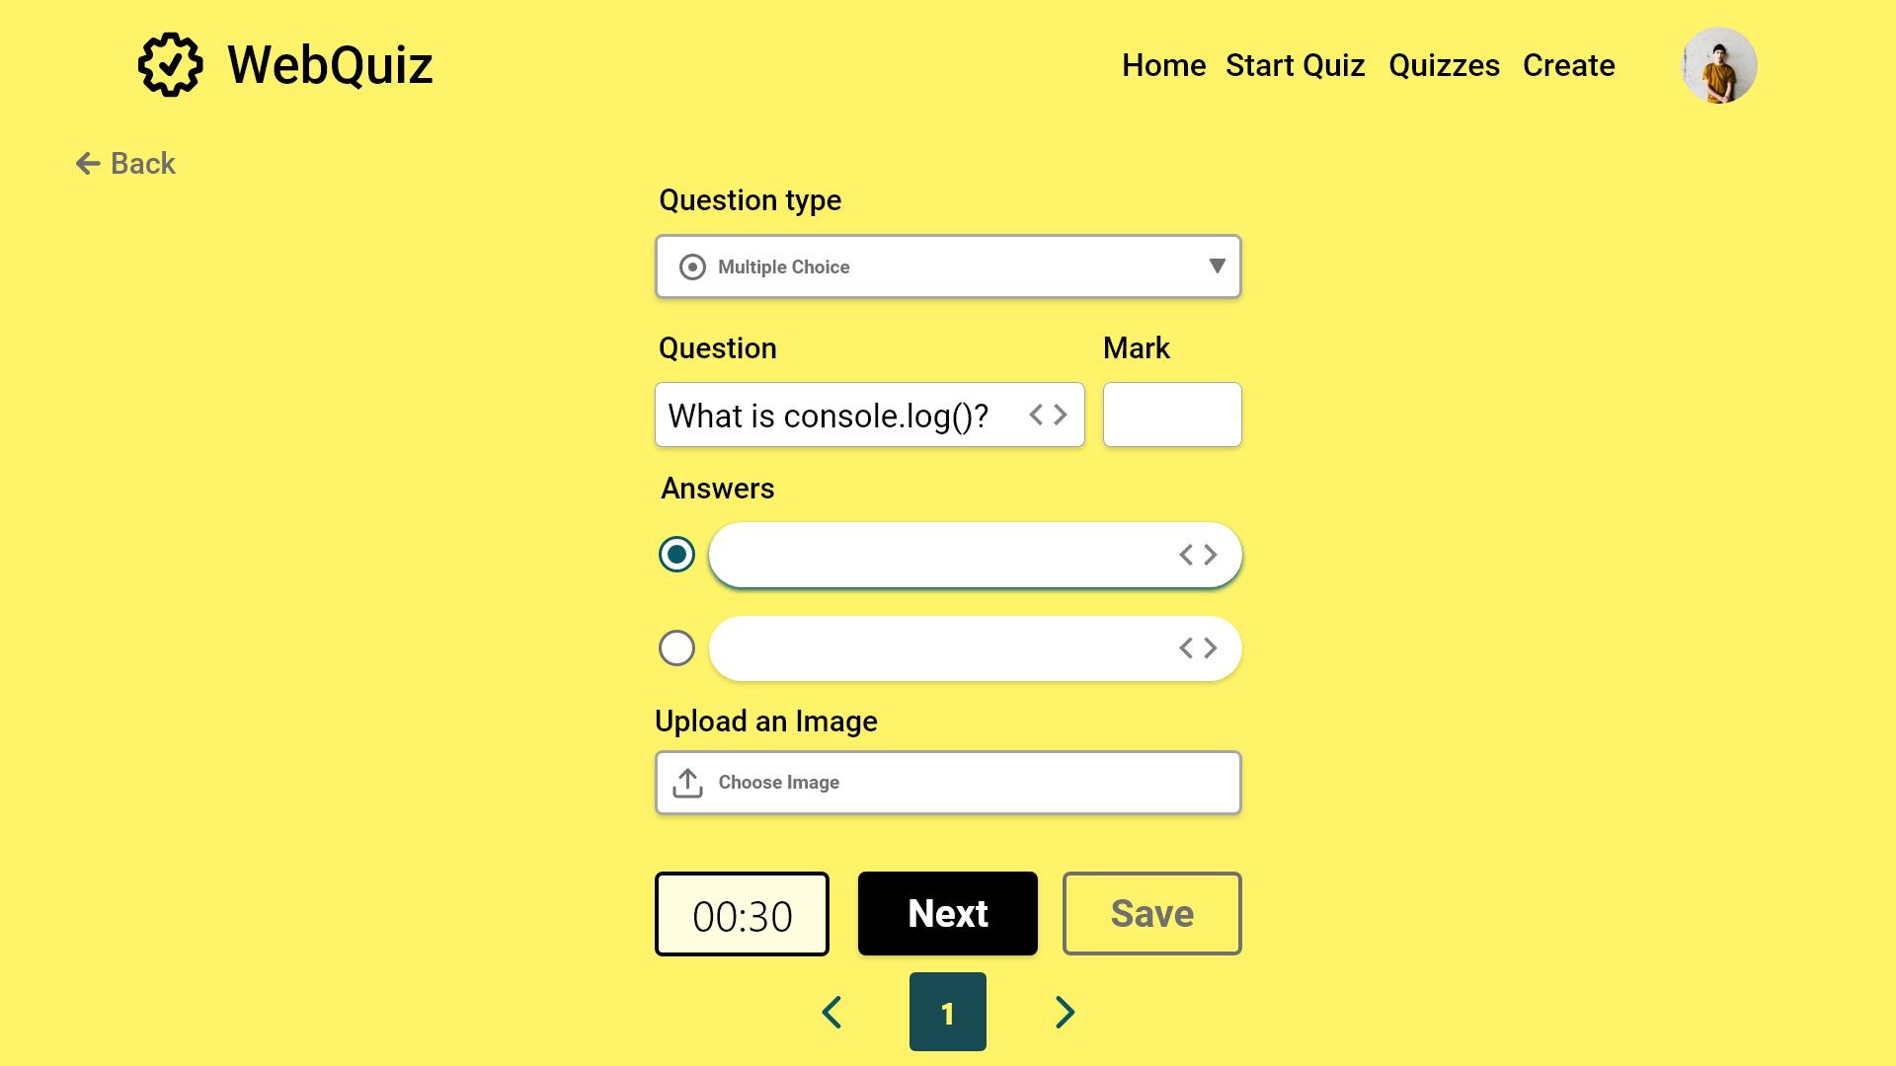

Slide 27


Slide 28
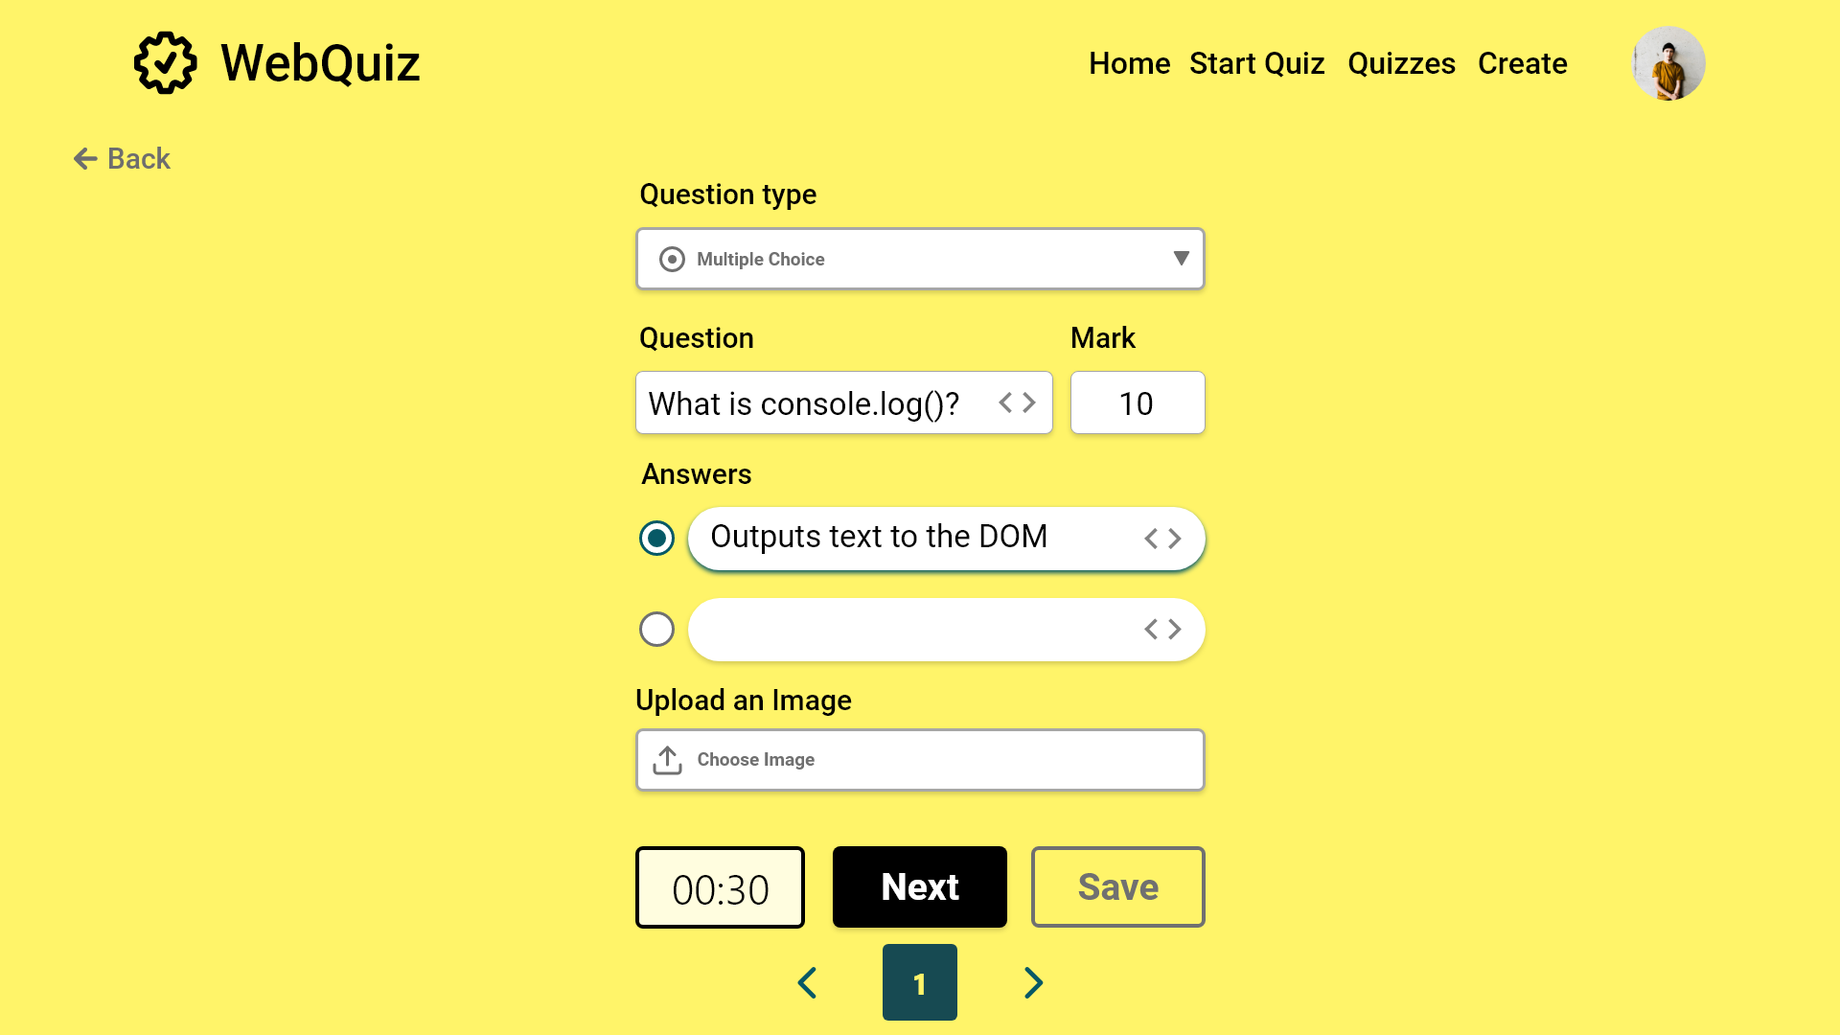

Slide 29
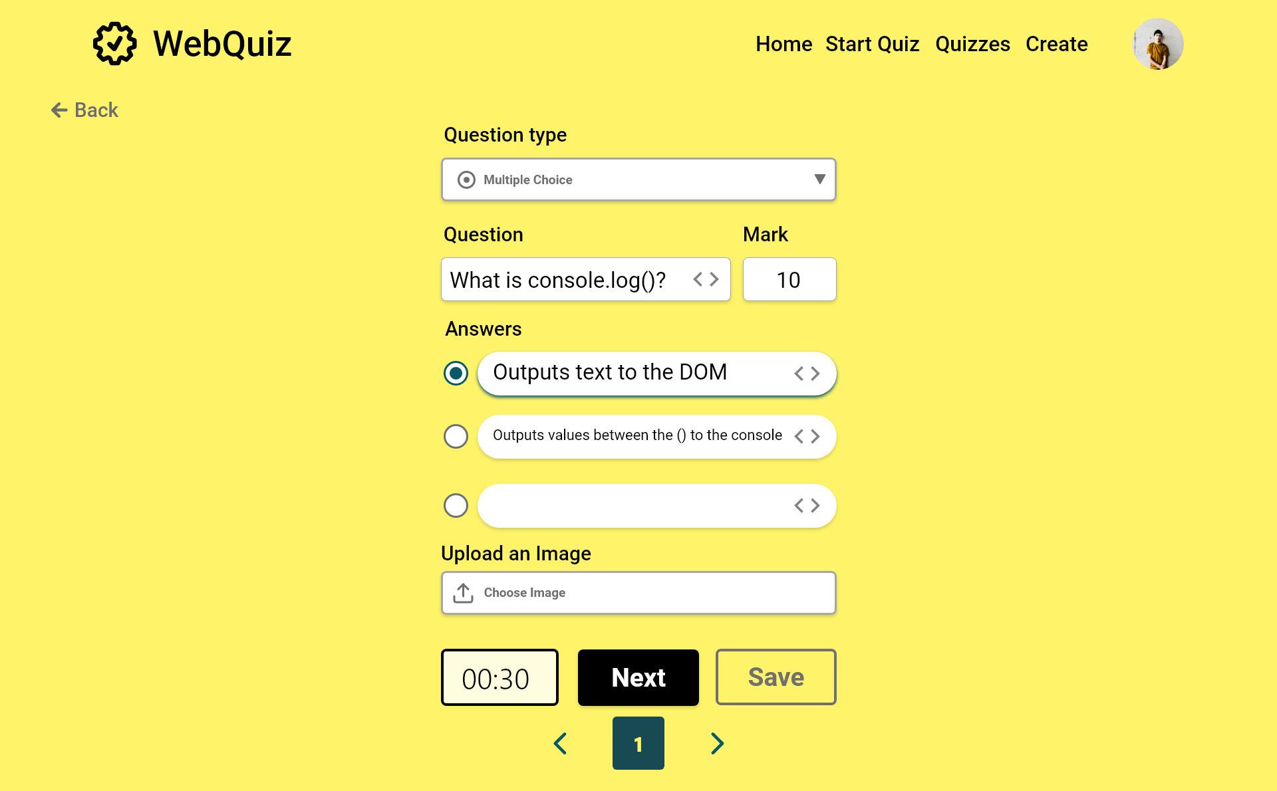

Slide 30
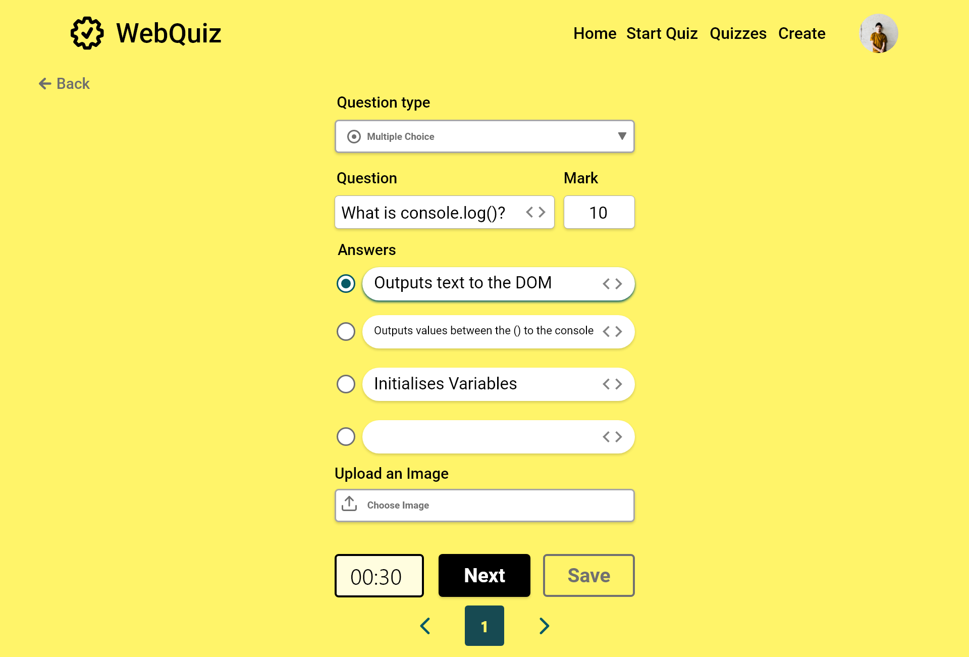

Slide 31
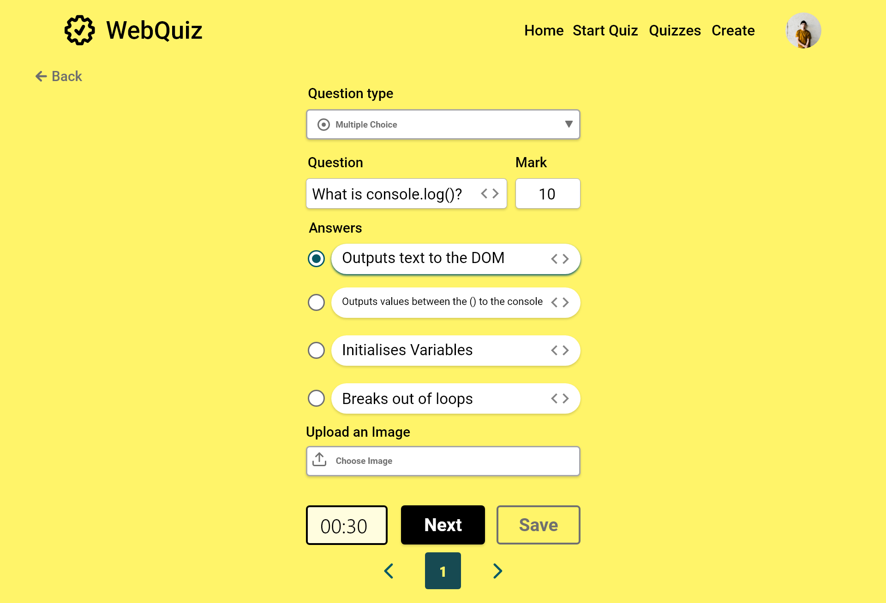

Slide 32
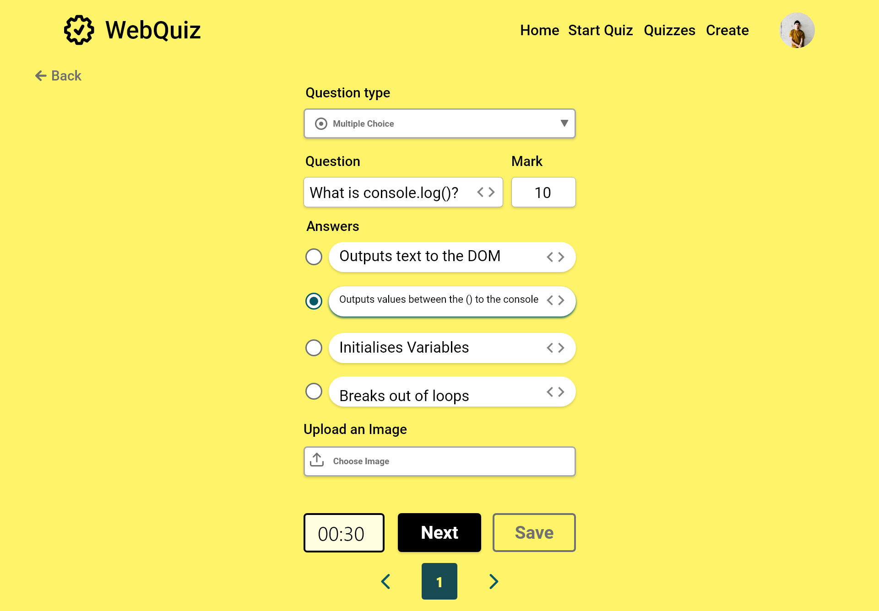

Slide 33
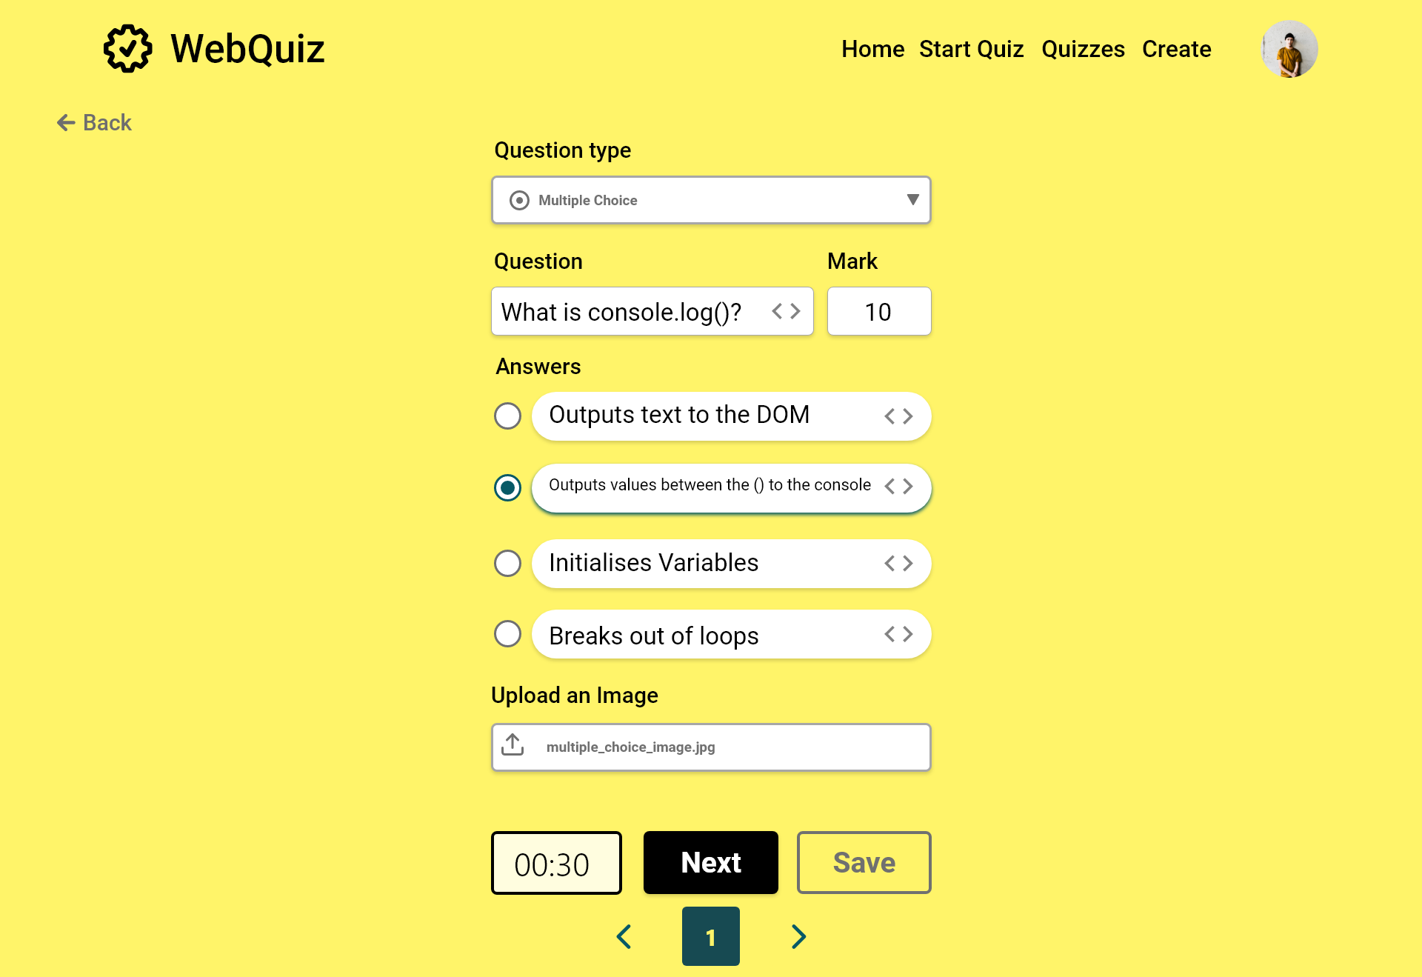

Slide 34


Slide 35
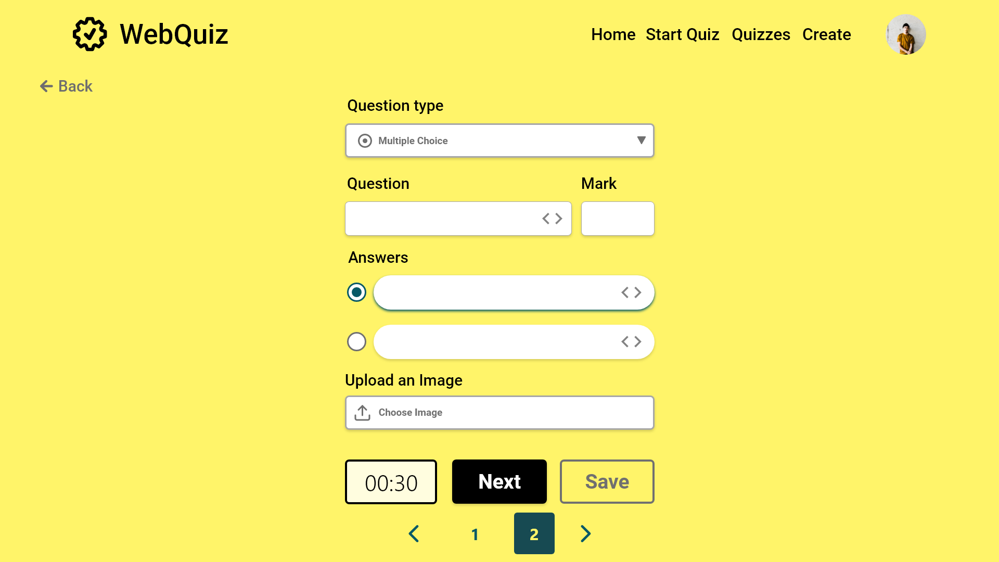

Slide 36
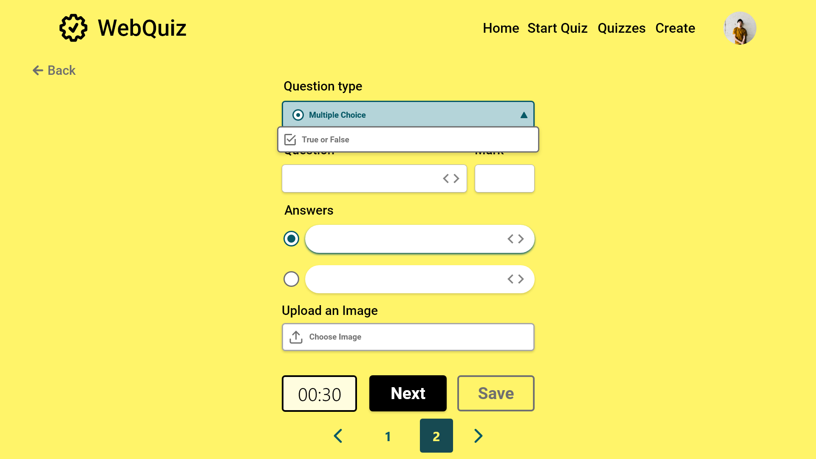

Slide 37
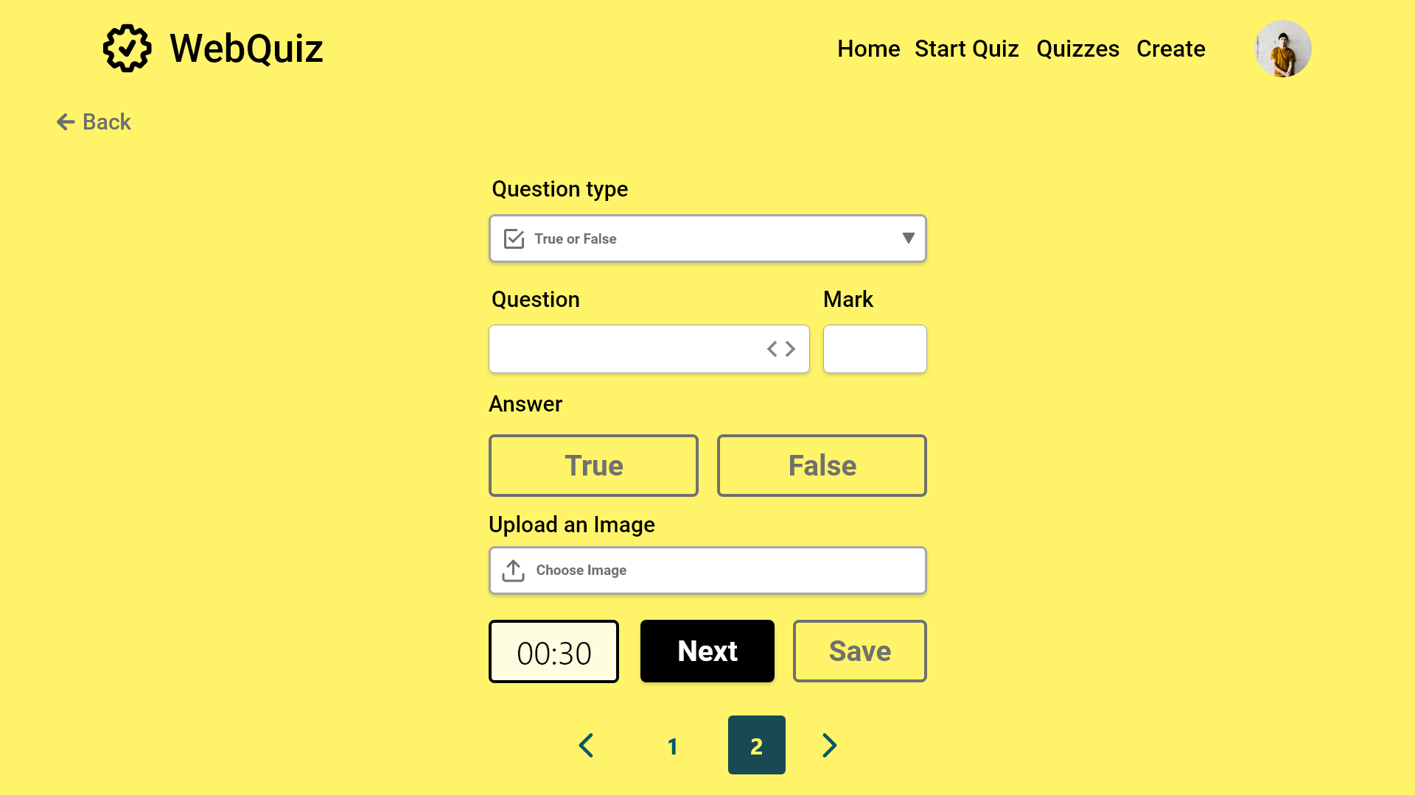
Error case

Slide 38
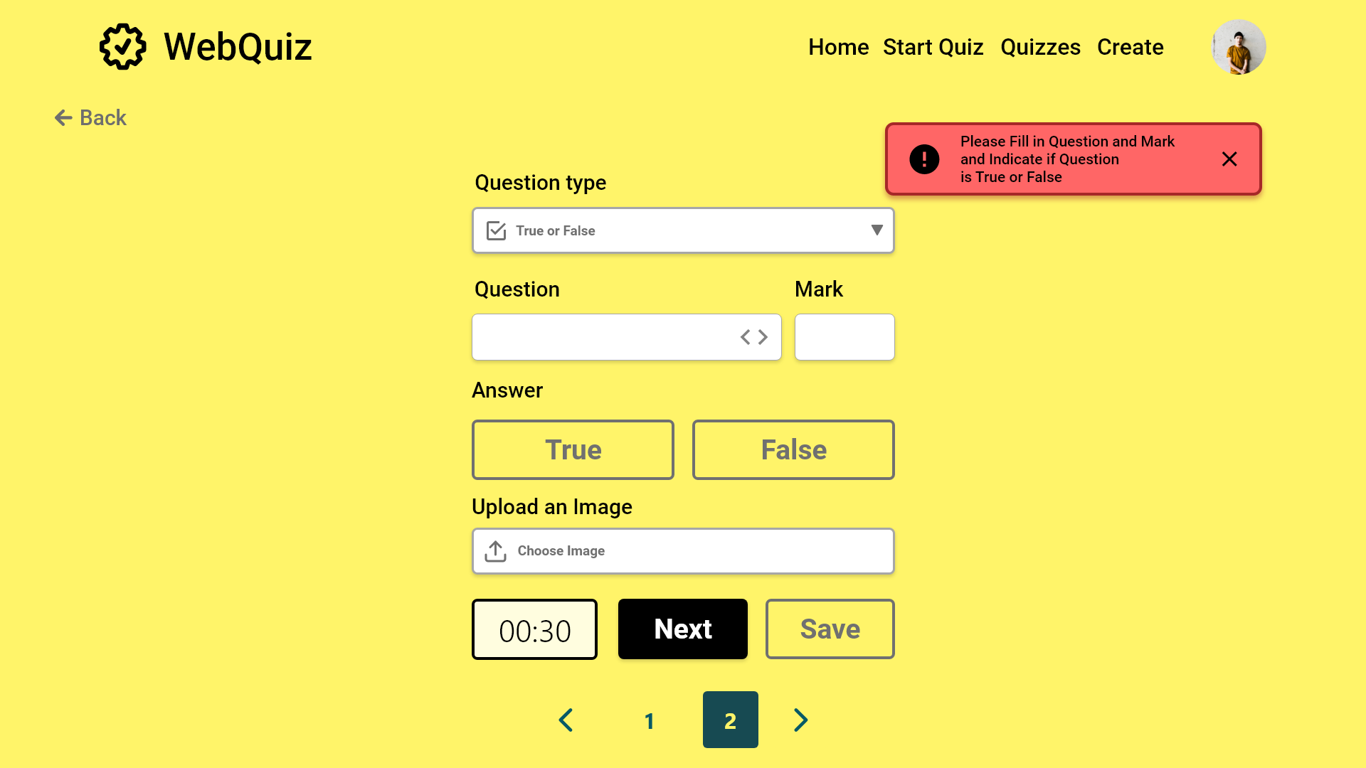

Slide 39
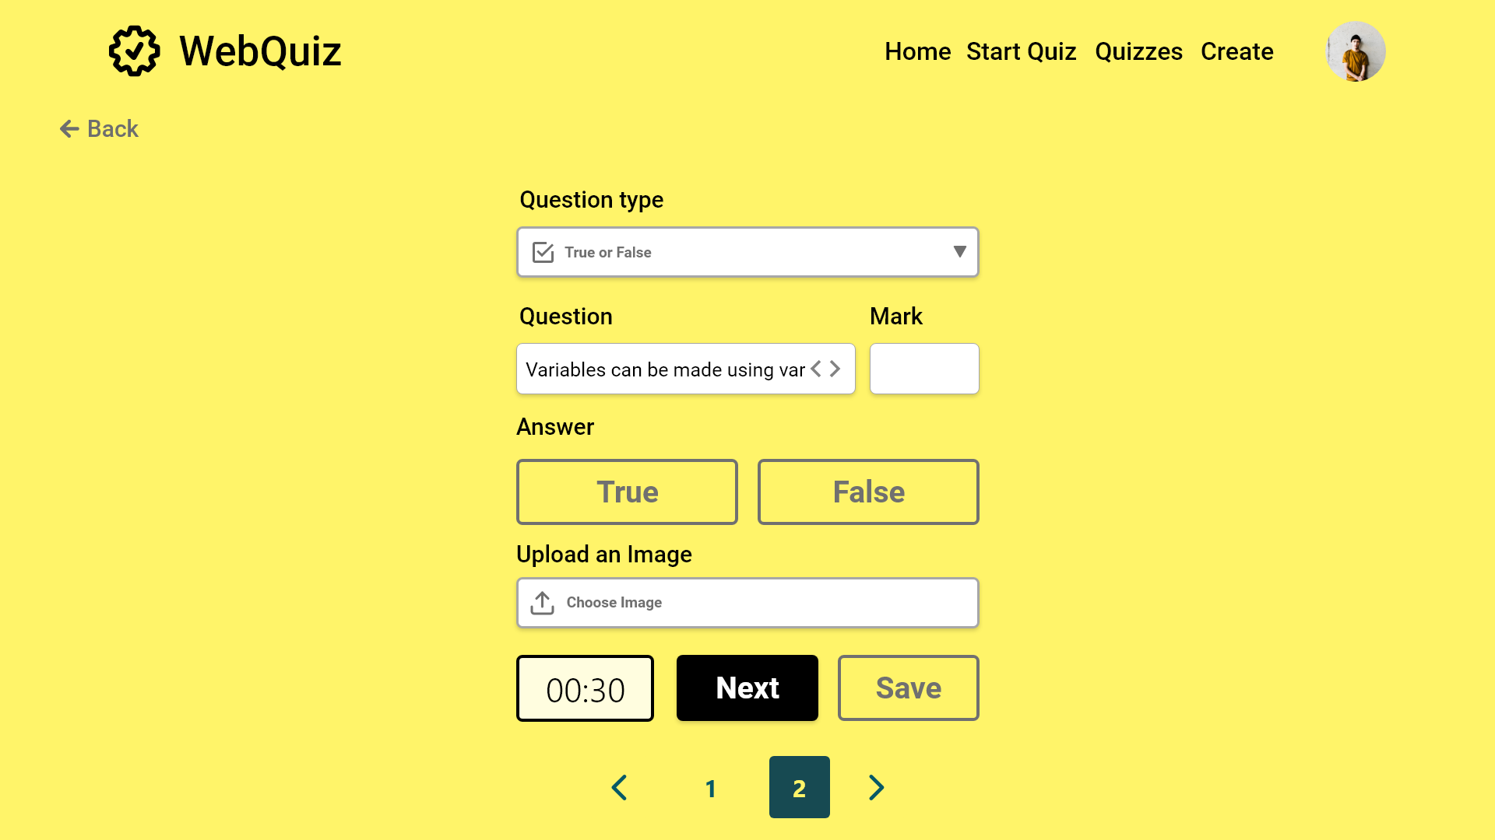

Slide 40
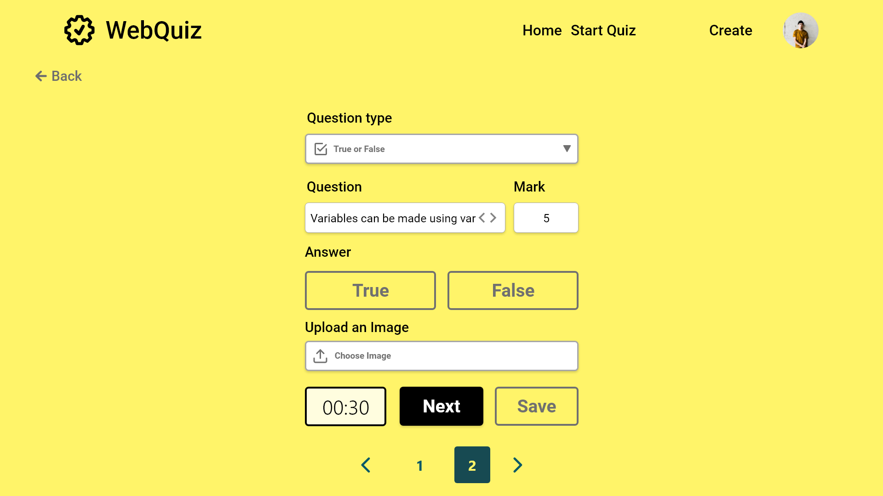


Slide 41
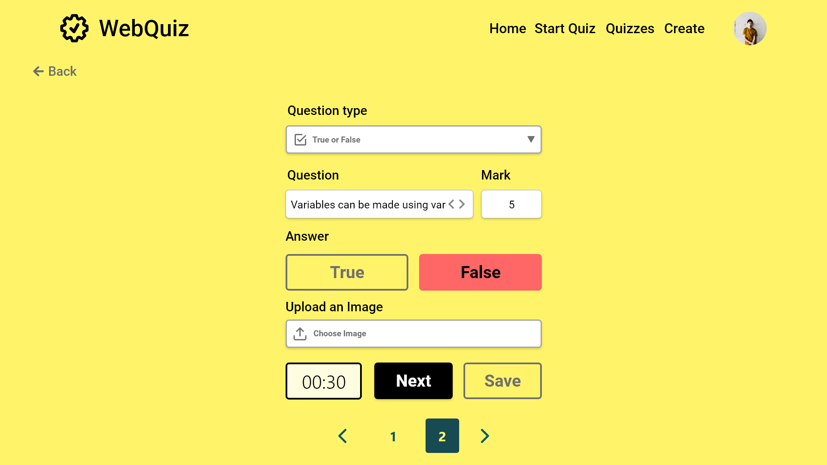

Slide 42
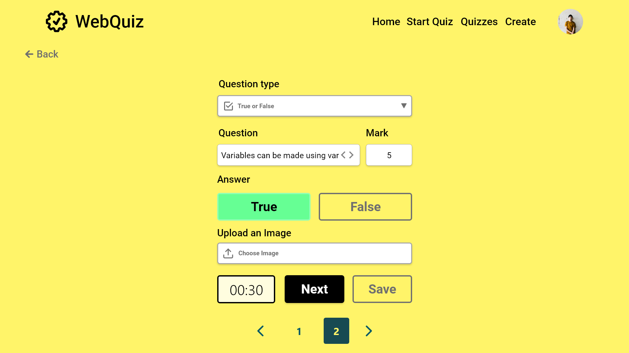

Slide 43


Slide 44


Slide 45
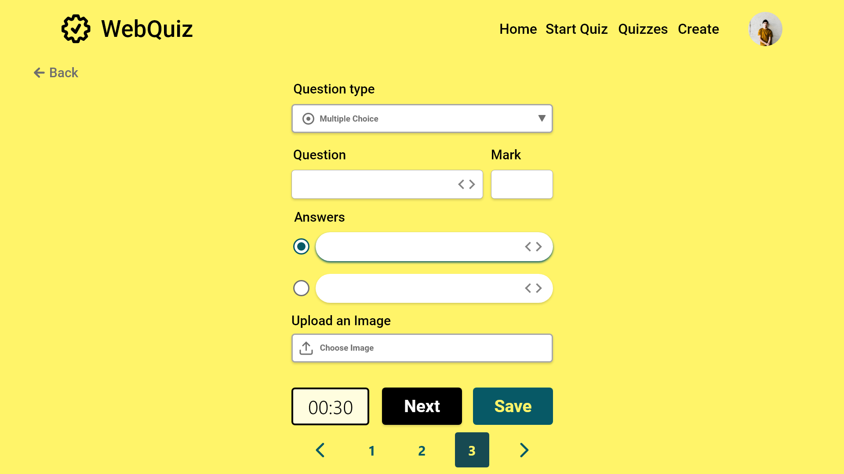

Slide 46
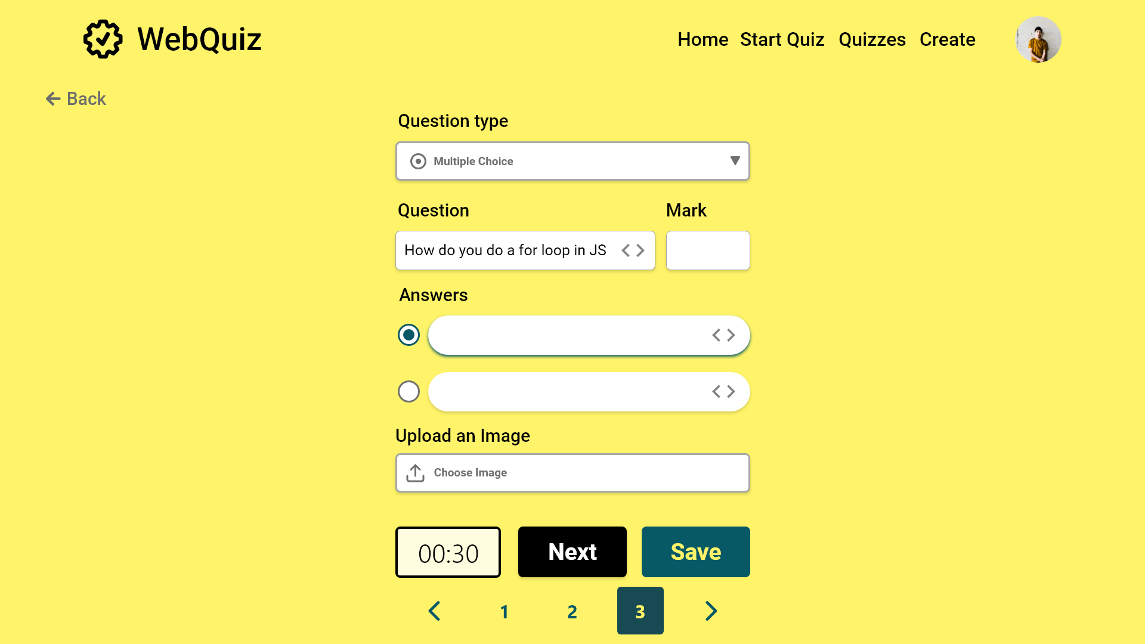

Slide 47


Slide 48
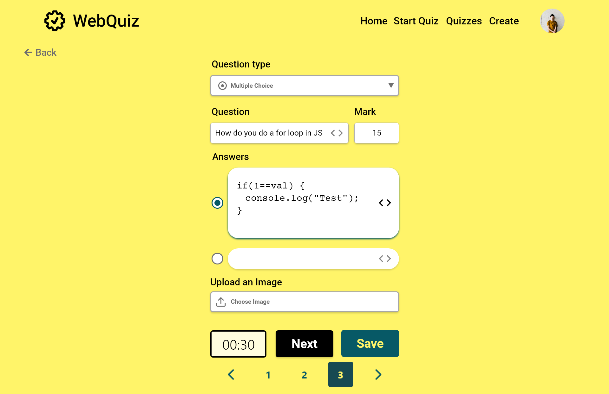

Slide 49
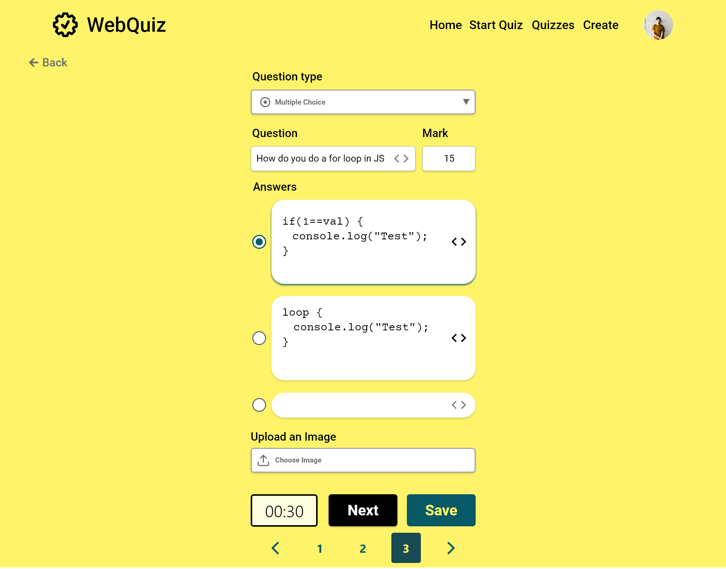

Slide 50
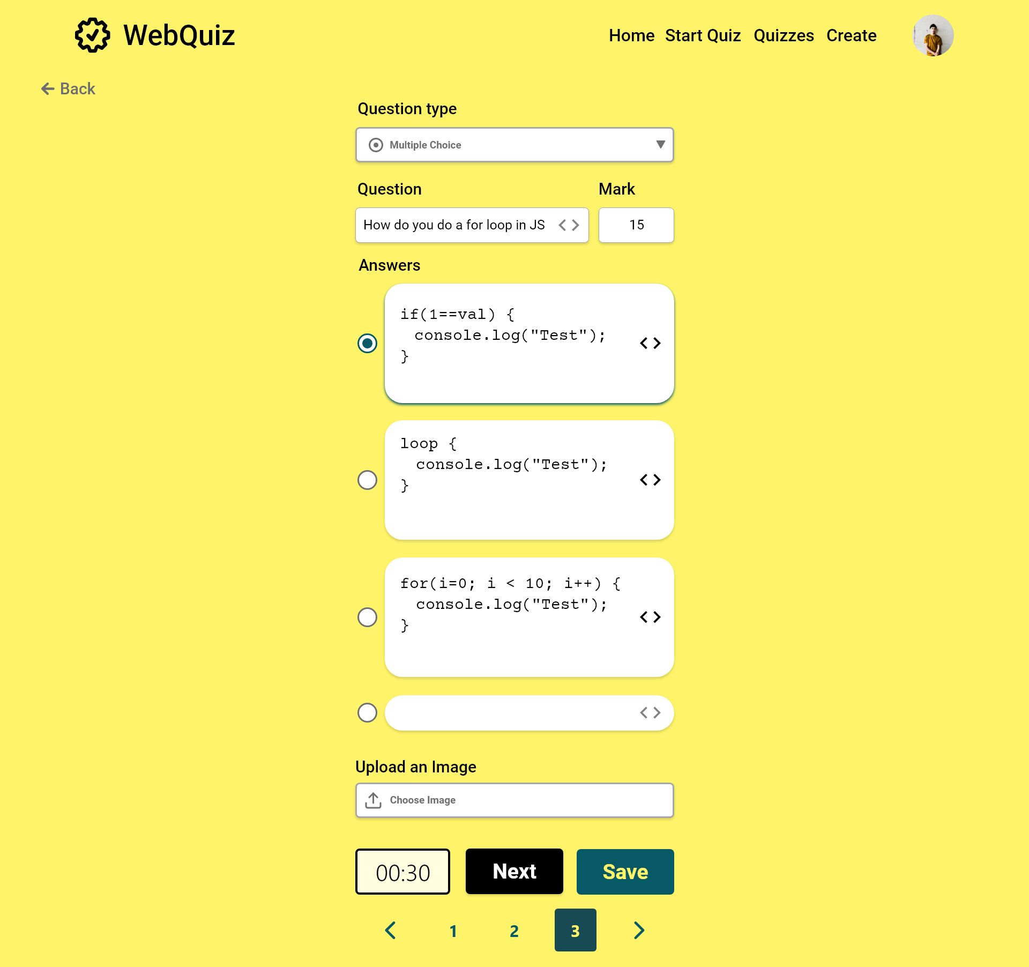

Slide 51
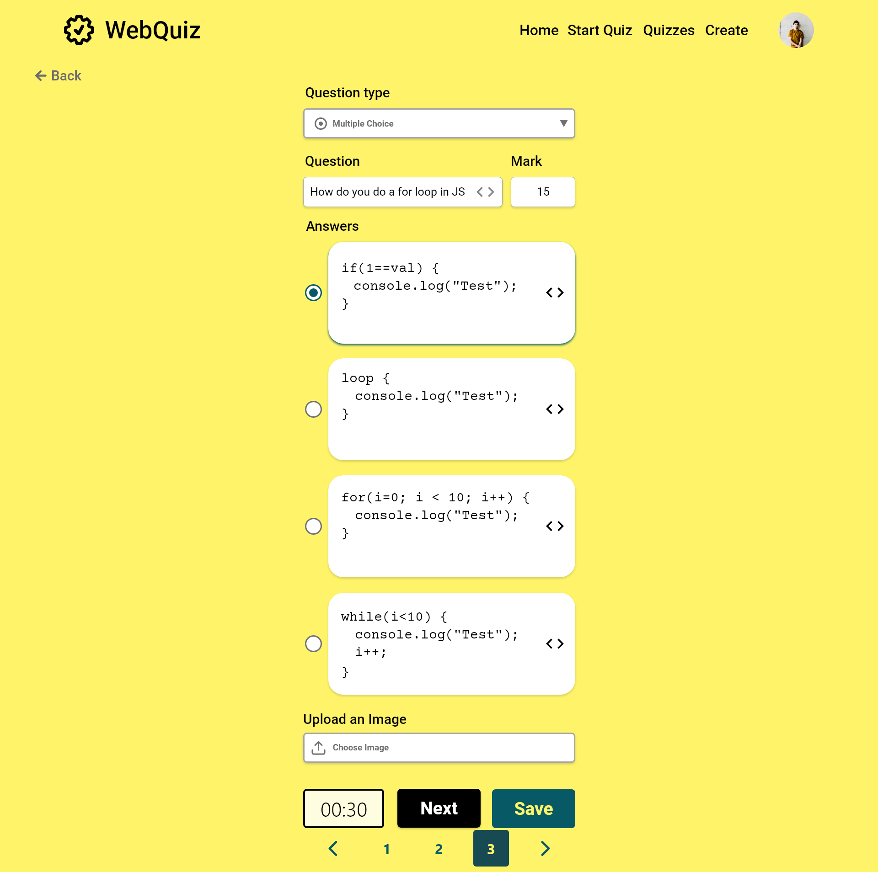

Slide 52


Slide 53
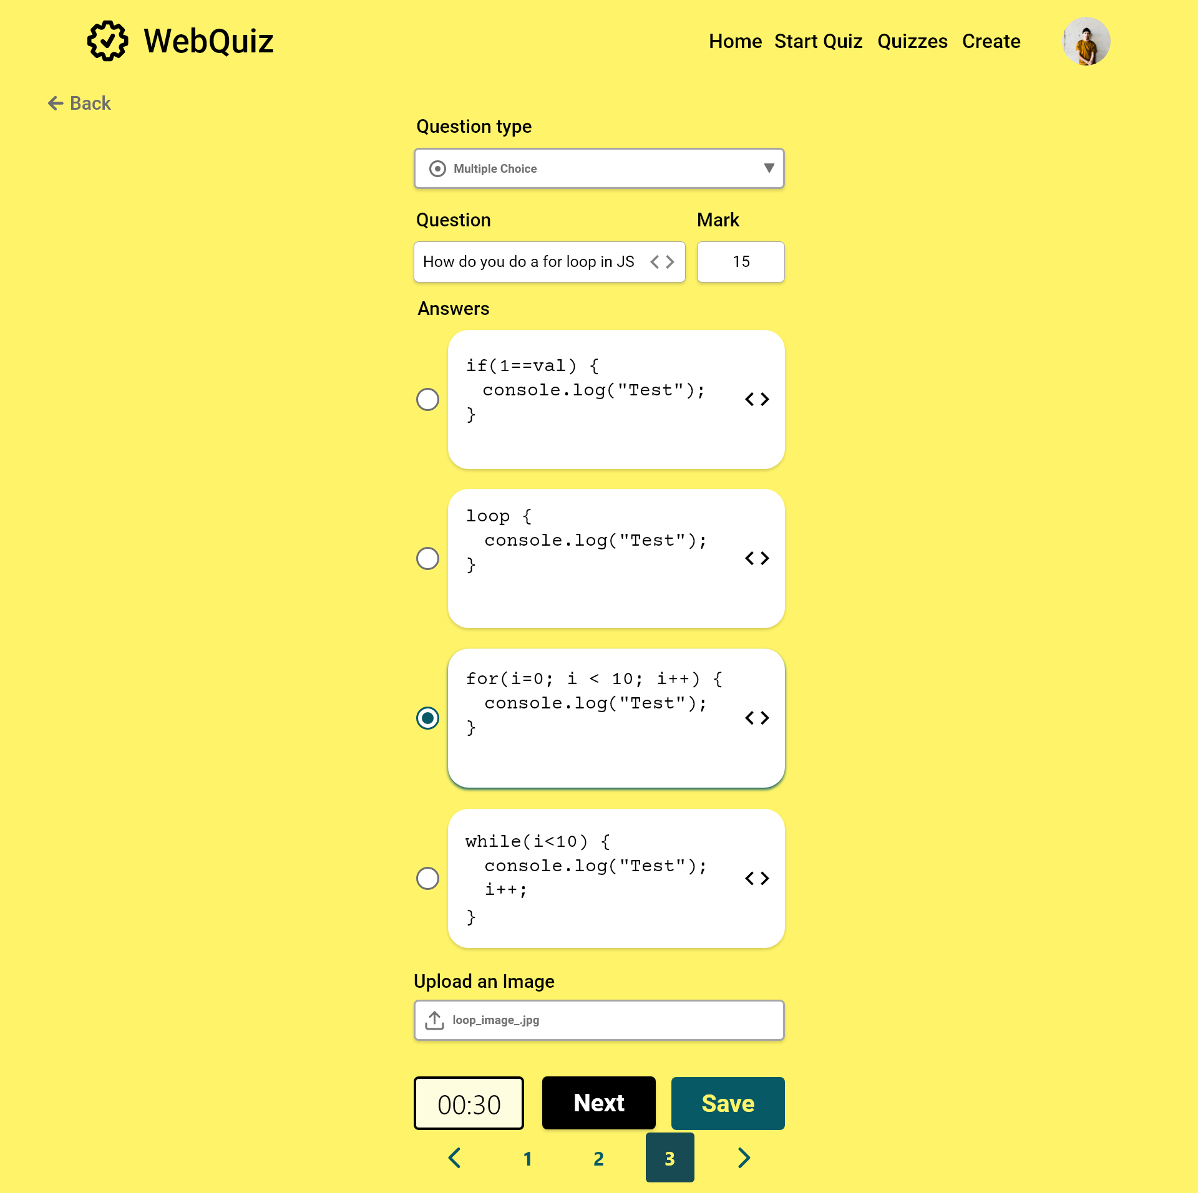

Slide 54
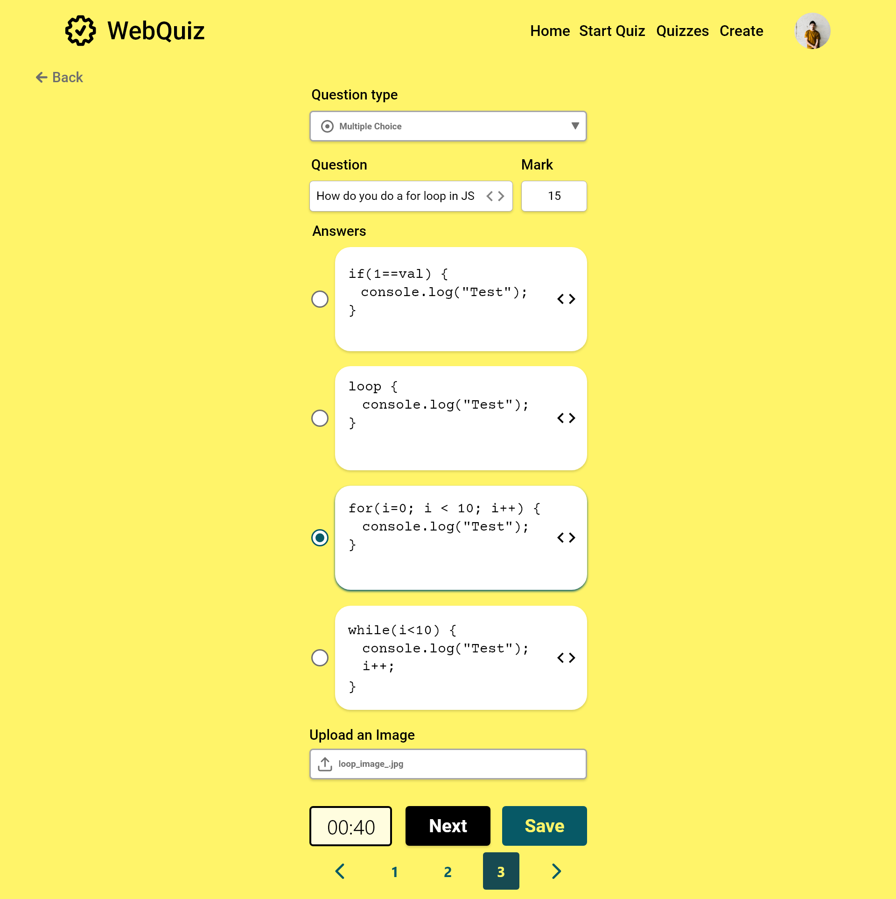

Slide 55
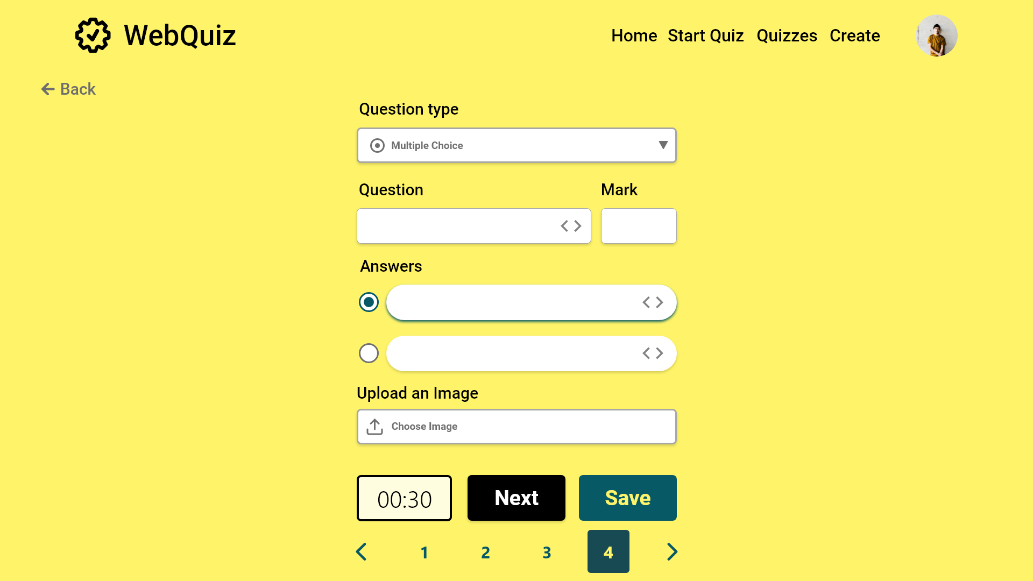

Slide 56
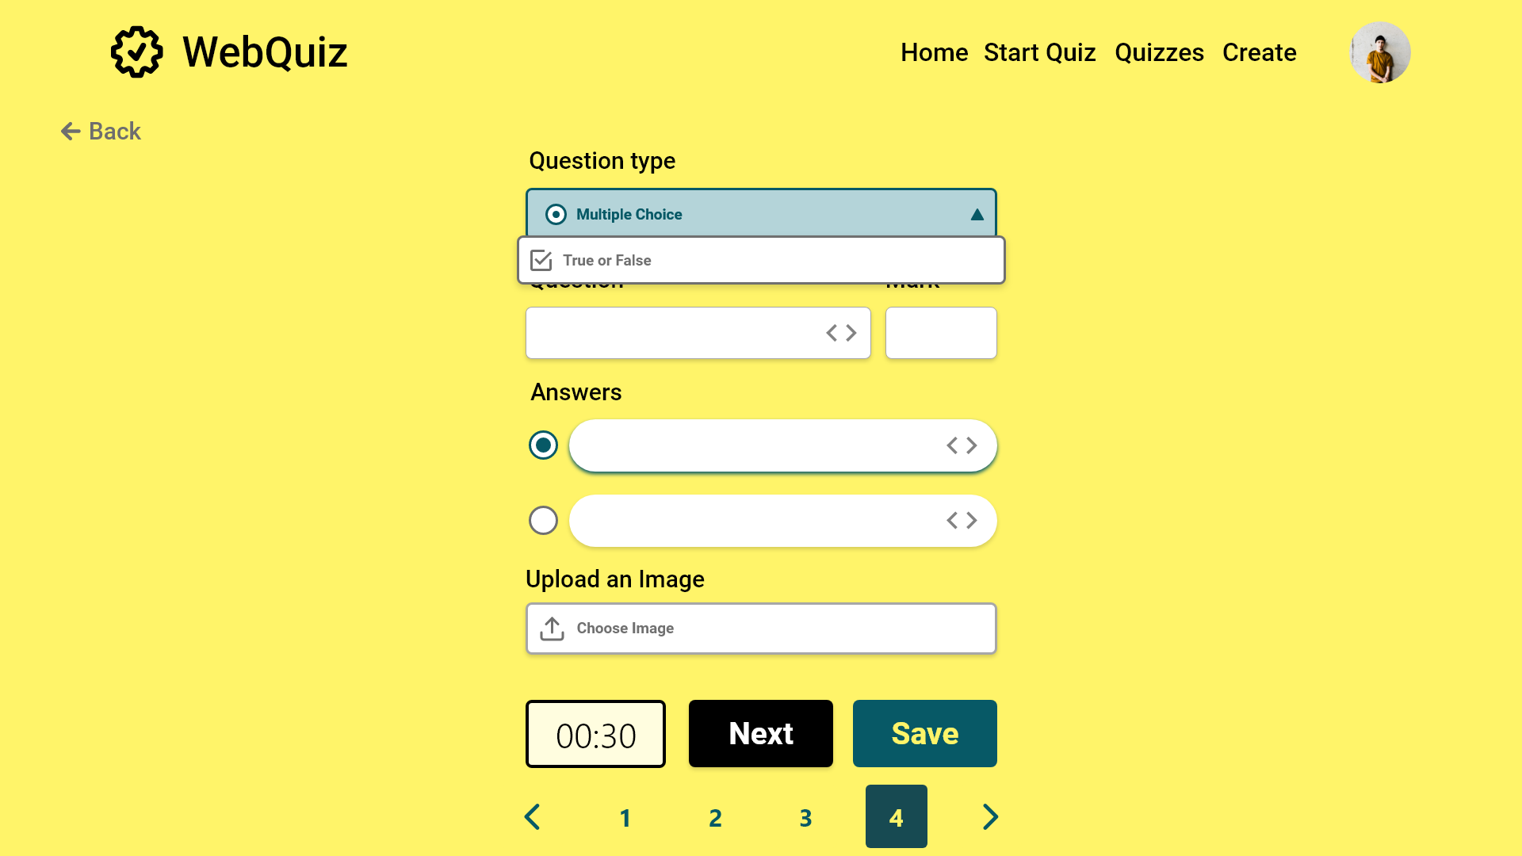

Slide 57
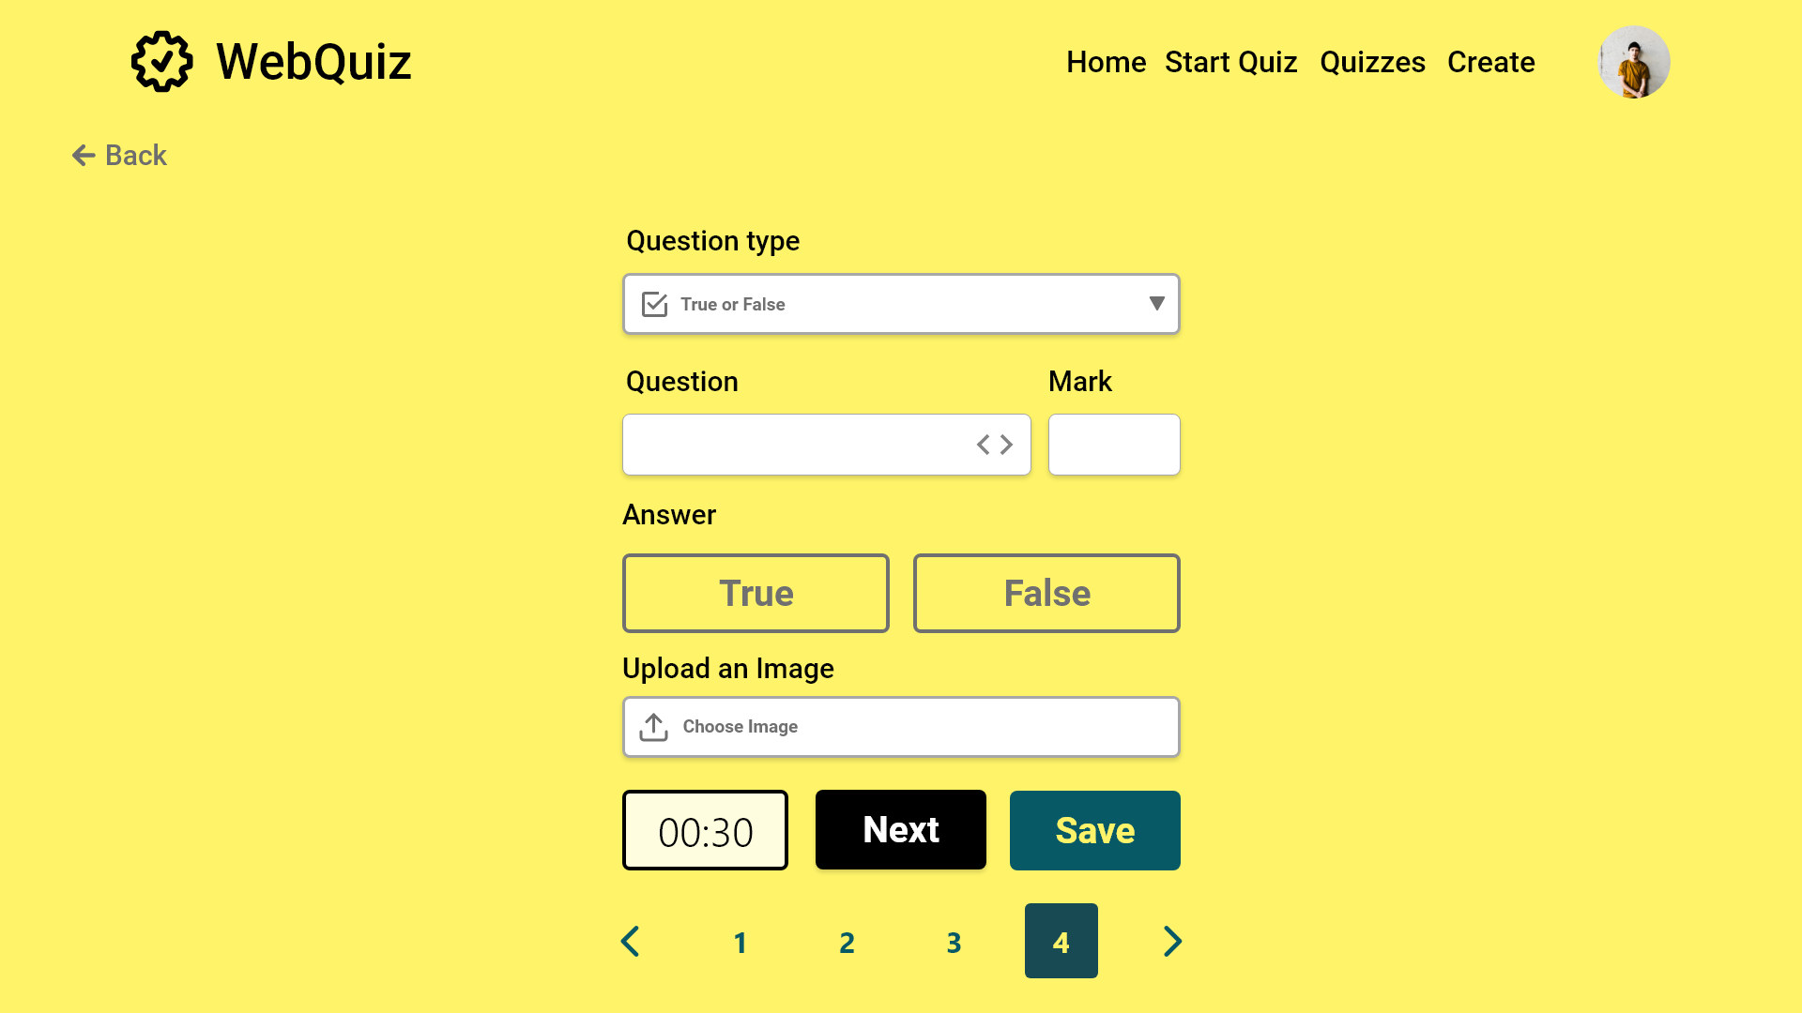

Slide 58


Slide 59


Slide 60
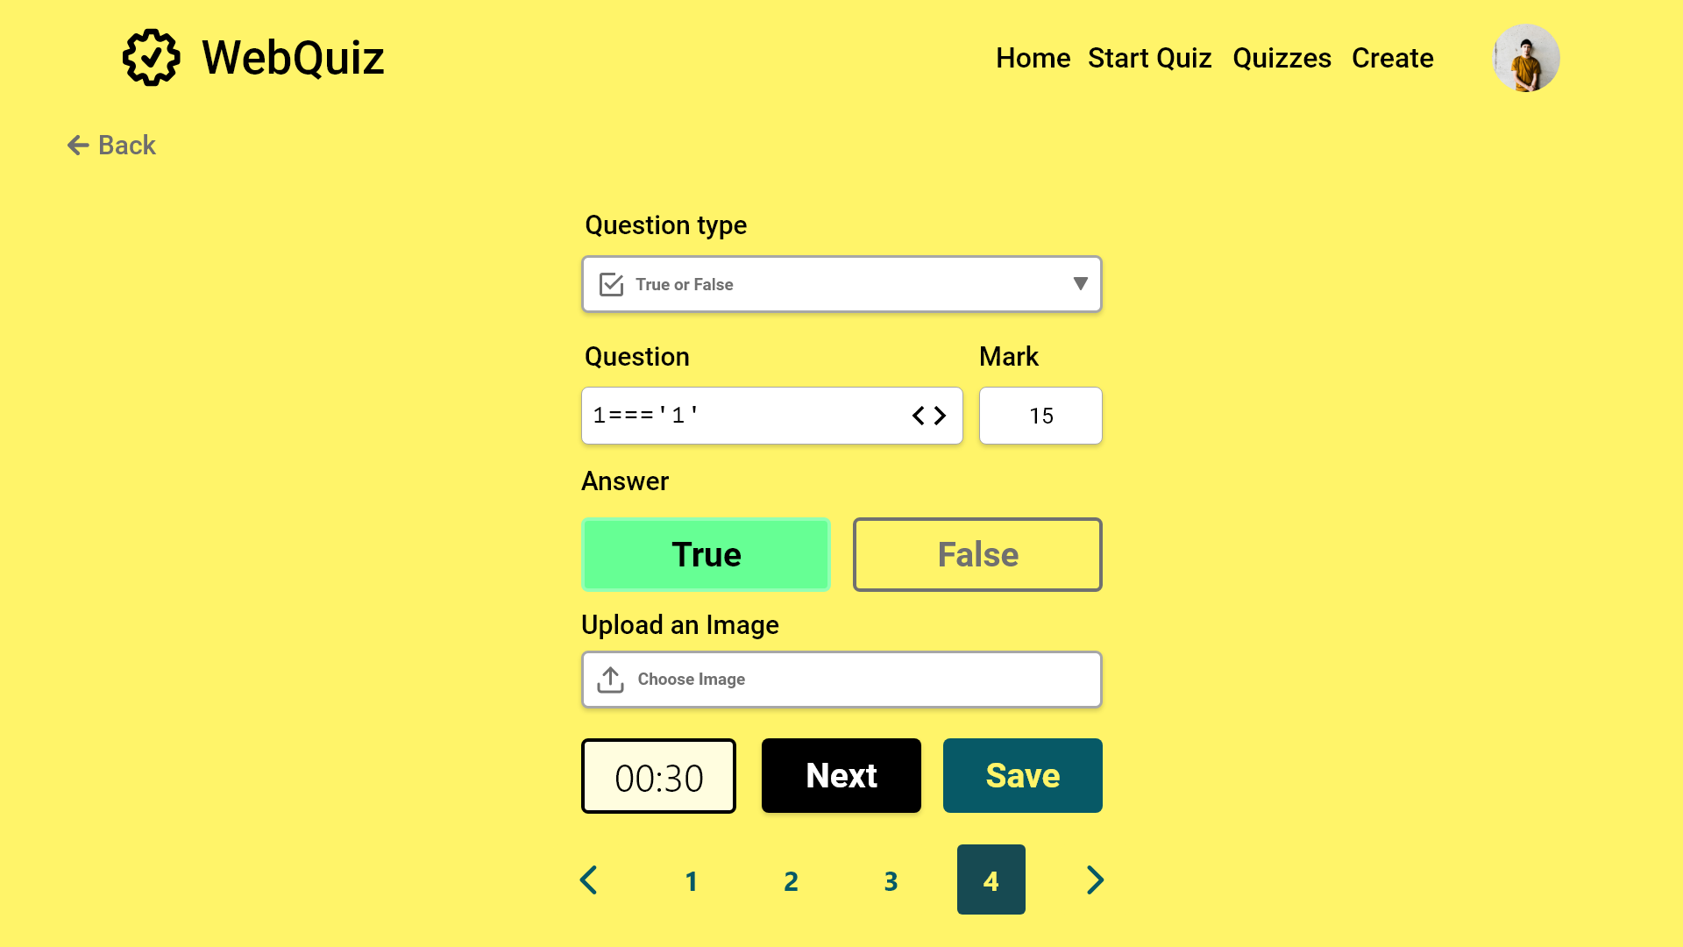

Slide 61
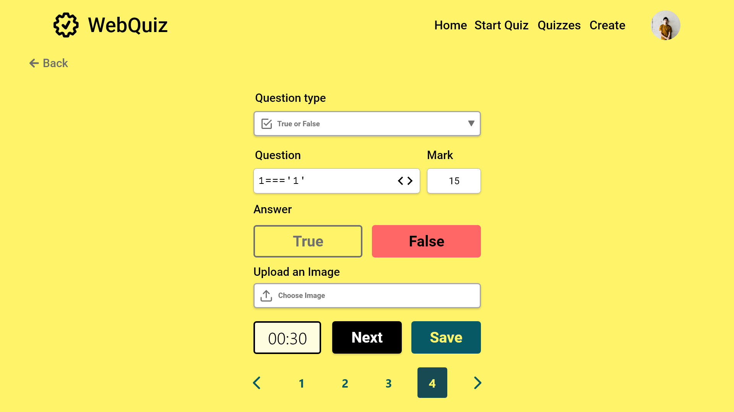

Slide 62


Slide 63


Slide 64
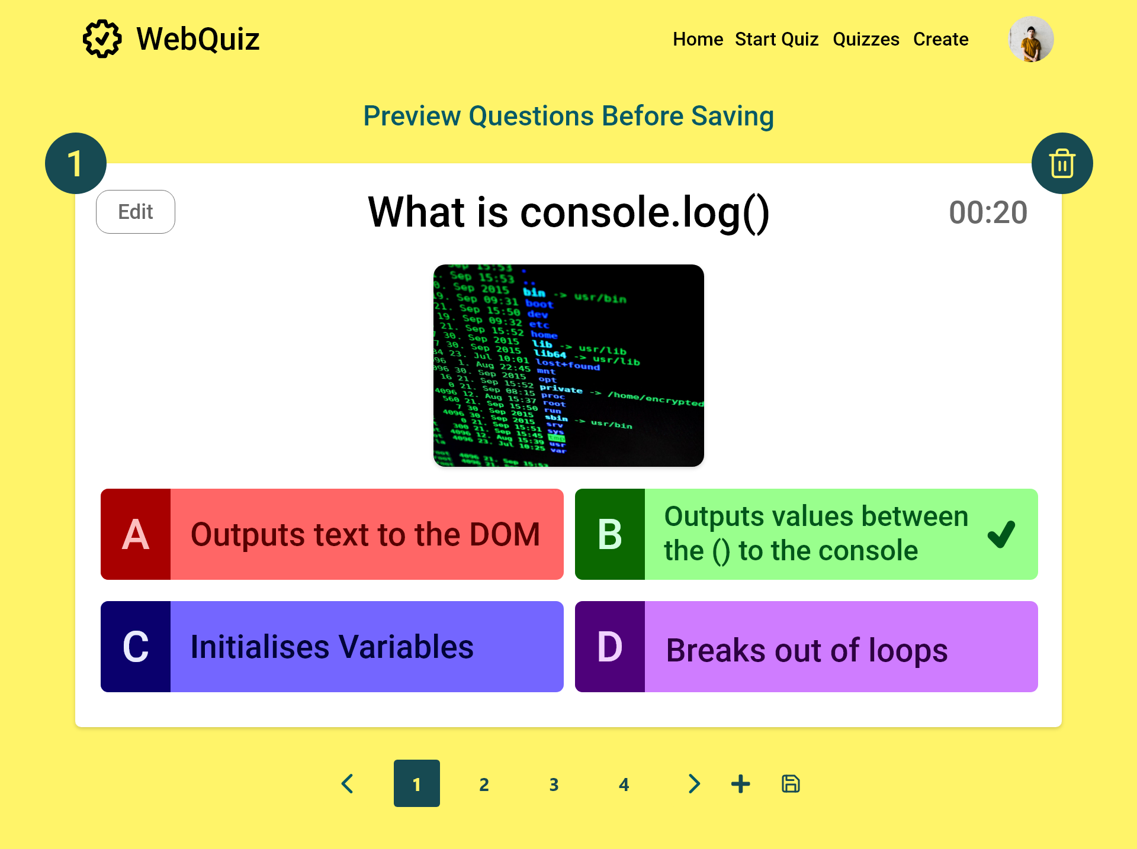
Delete Question
Edit Question
Add question
Save

Slide 65
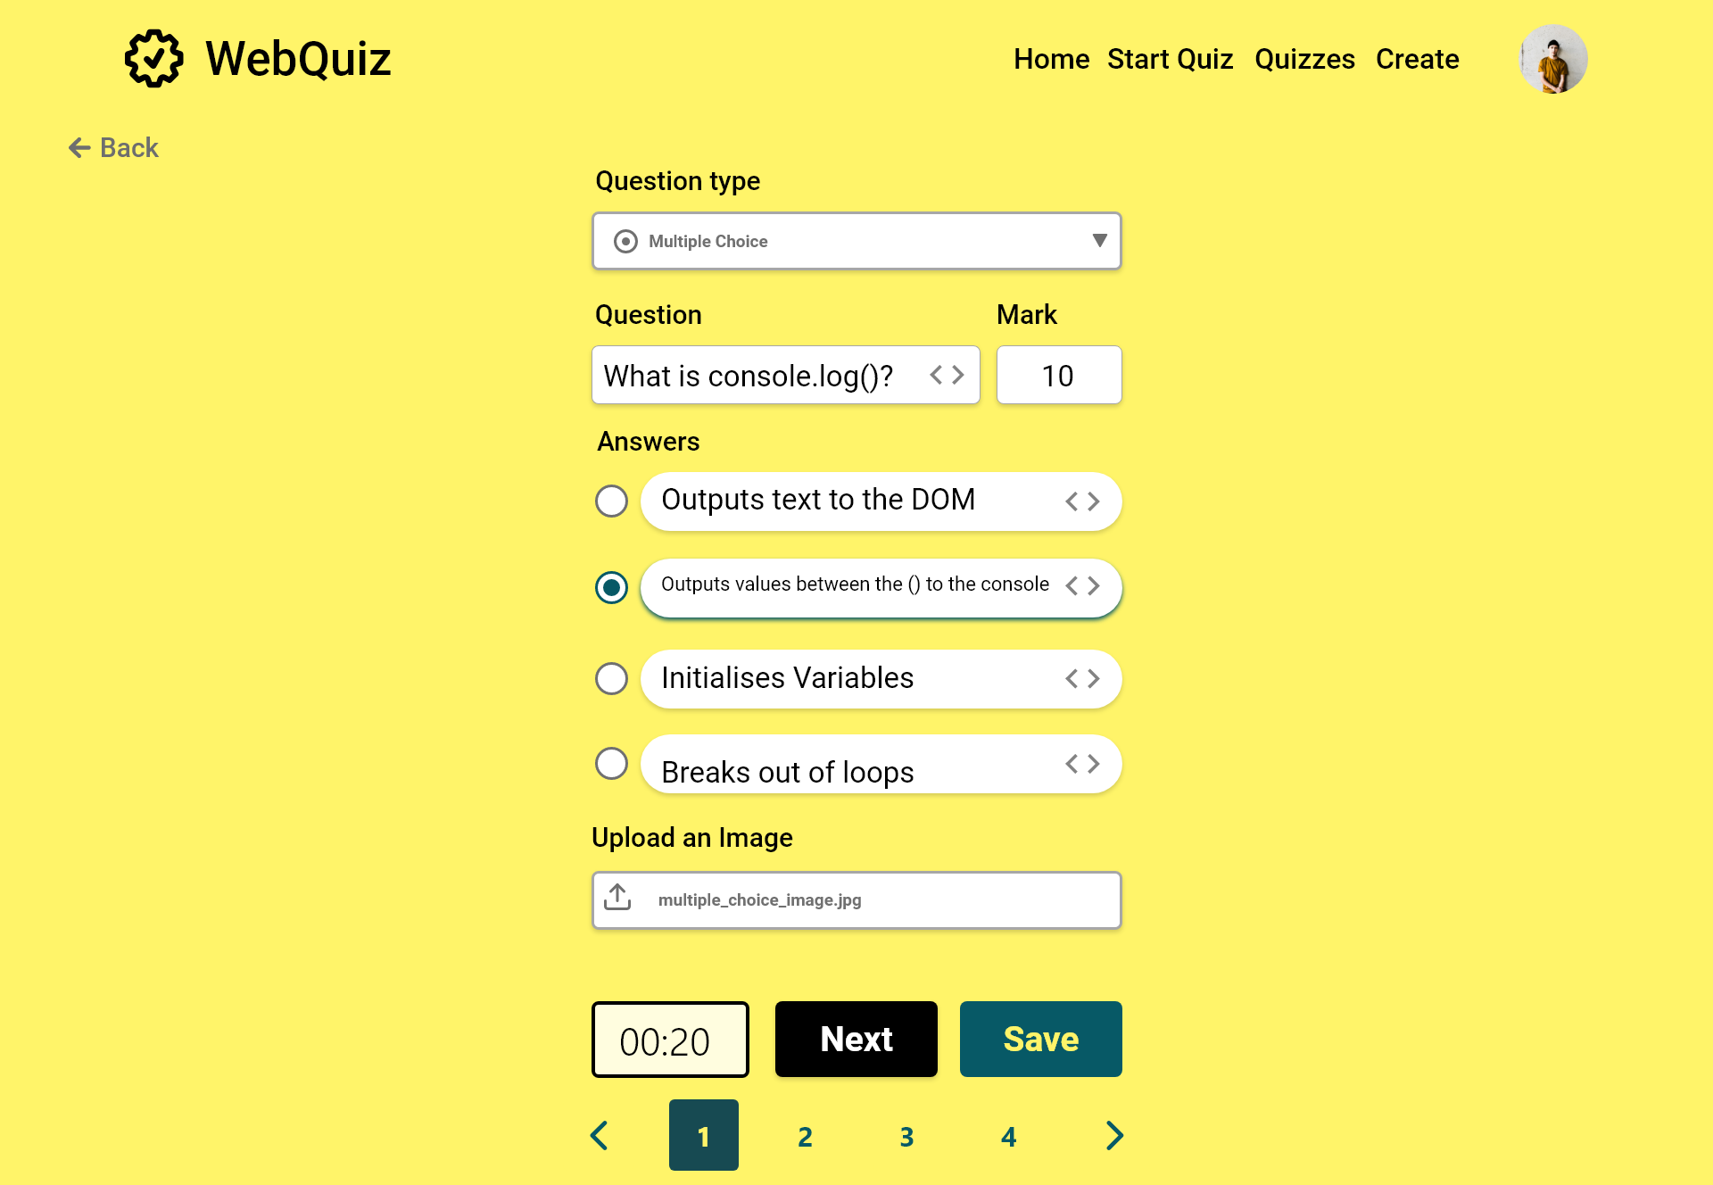

Slide 66
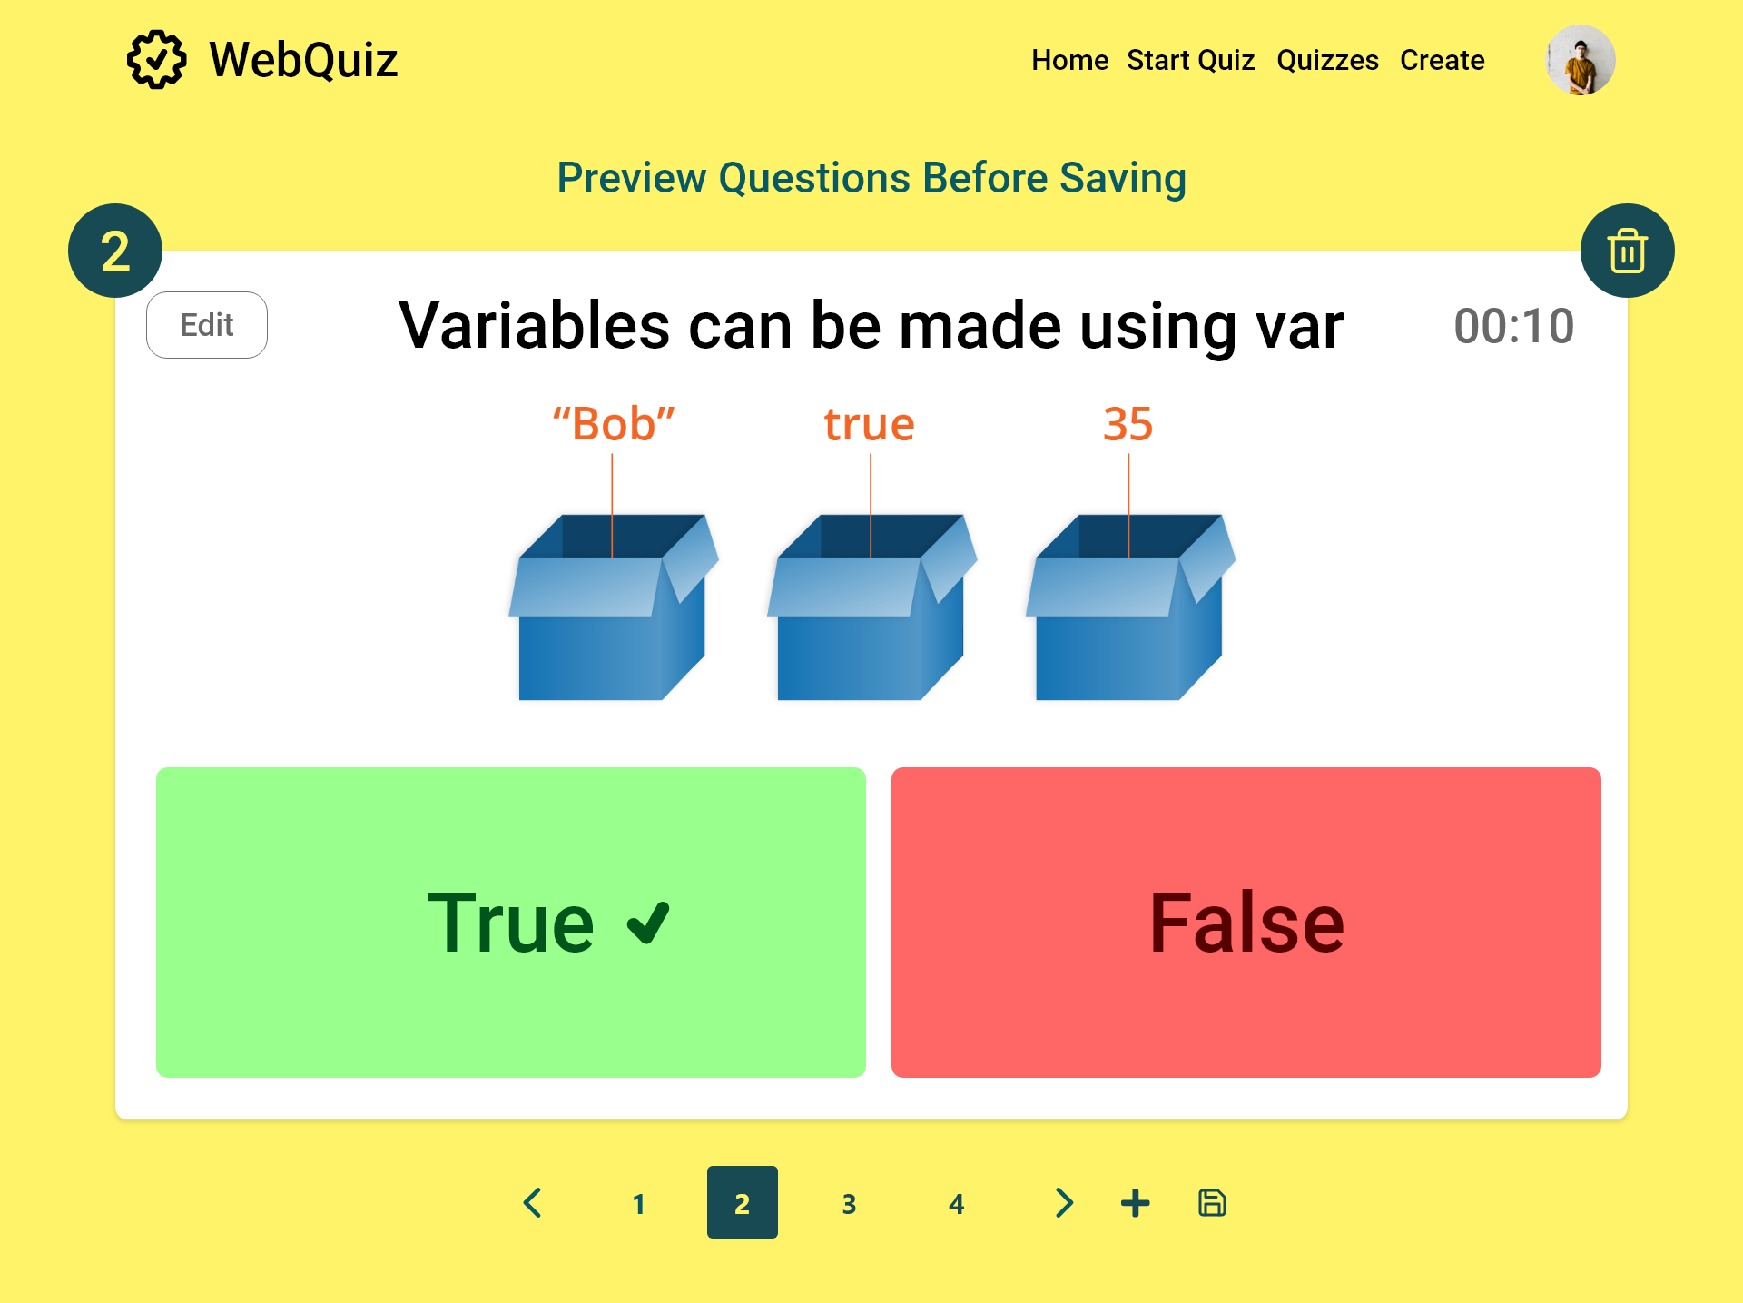

Slide 67


Slide 68


Slide 69


Slide 70


Slide 72

Undo Delete

Slide 73
Quizzes

Slide 74


Slide 75


Slide 76


Slide 77


Slide 78


Slide 79


Slide 80


Slide 81


Slide 82
Start Quiz Menu

Slide 83


Slide 84
Start Quiz

Slide 85

Turn off timer
Start quiz
Change between
participant and Quiz Master

Slide 86

Turn on timer
Start quiz
Change between
participant and Quiz Master

Slide 87

Change between
participant and Quiz Master

Slide 88
Question 1

Slide 89

Change between
participant and Quiz Master

Slide 90

Change between
participant and Quiz Master

Slide 91
Participant view Question 1

Slide 92

Change between
participant and Quiz Master

Slide 93

Change between
participant and Quiz Master

Slide 94

Change between
participant and Quiz Master

Slide 95

Change between
participant and Quiz Master

Slide 96
Question 2

Slide 97

Case where need to end quiz early
Change between
participant and Quiz Master

Slide 98

Case where need to end quiz early
Change between
participant and Quiz Master

Slide 99
Participant view Question 2

Slide 100

Change between
participant and Quiz Master

Slide 101

Change between
participant and Quiz Master

Slide 102

Change between
participant and Quiz Master

Slide 103

Change between
participant and Quiz Master

Slide 104
Question 3

Slide 105

Change between
participant and Quiz Master

Slide 106
Change between
participant and Quiz Master

Slide 107
Participant view Question 3

Slide 108

Change between
participant and Quiz Master

Slide 109

Change between
participant and Quiz Master

Slide 110

Change between
participant and Quiz Master

Slide 111

Change between
participant and Quiz Master

Slide 112
Question 4

Slide 113

Change between
participant and Quiz Master

Slide 114

Change between
participant and Quiz Master

Slide 115
Participant view Question 4

Slide 116

Change between
participant and Quiz Master

Slide 117

Change between
participant and Quiz Master

Slide 118

Change between
participant and Quiz Master

Slide 119

Change between
participant and Quiz Master

Slide 120
Results

Slide 121


Slide 122


Slide 123


